Slide 1
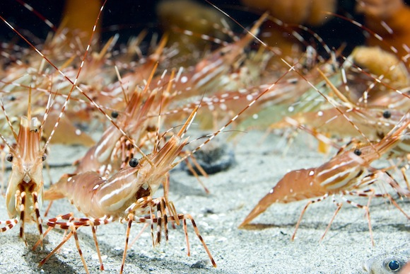
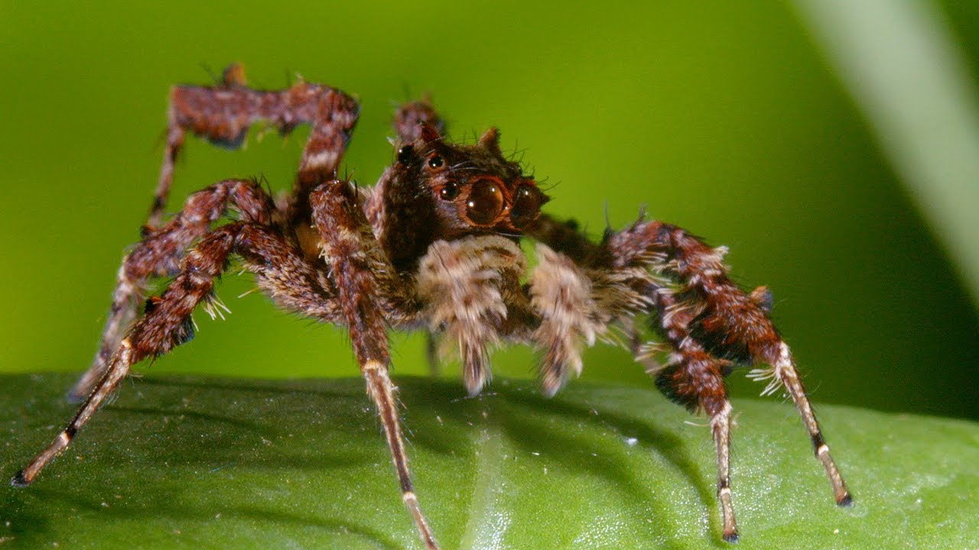
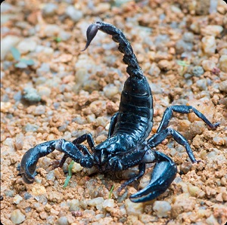
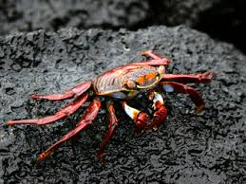
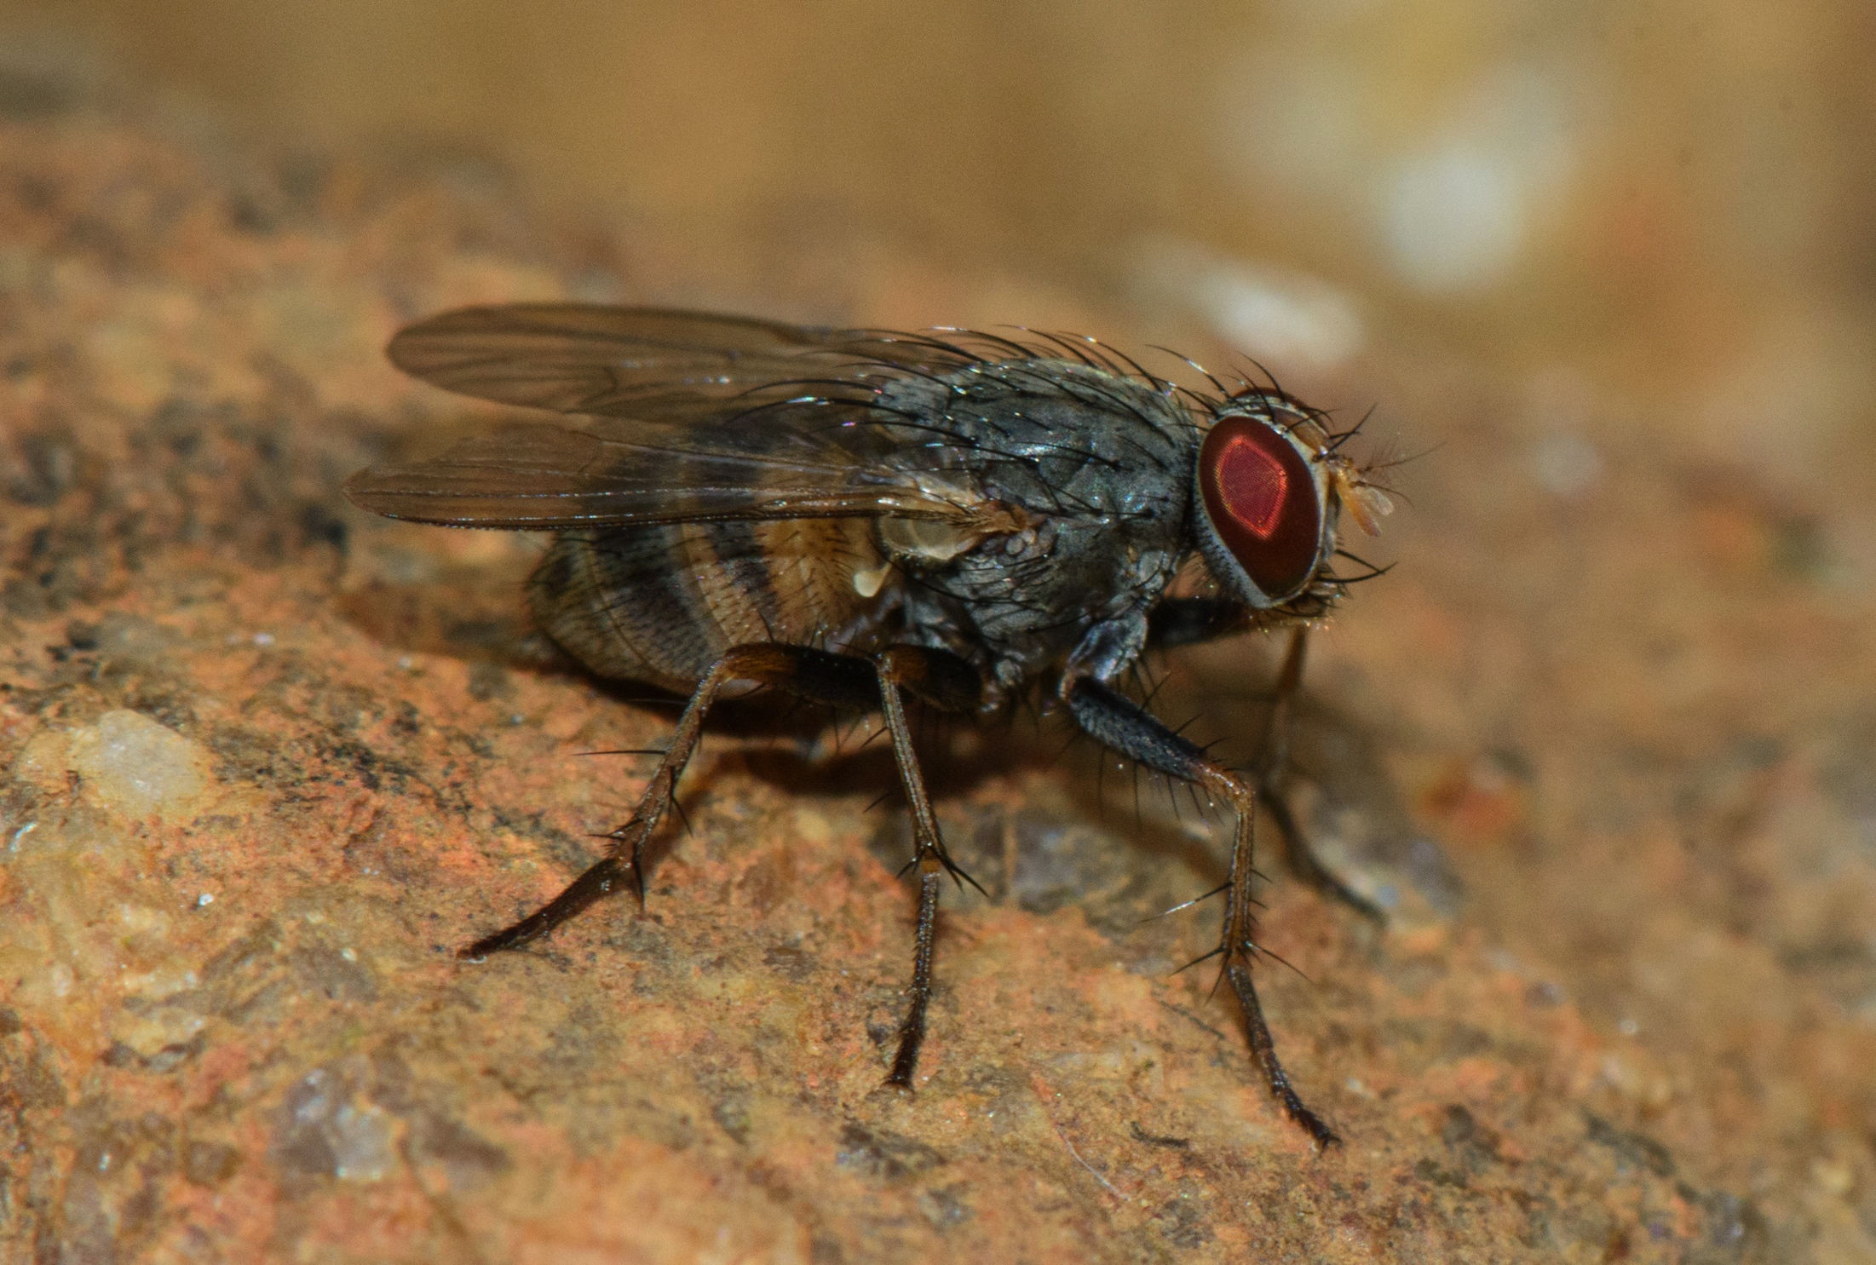
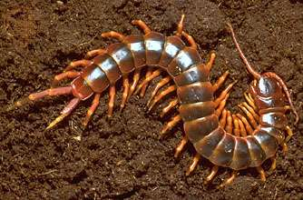
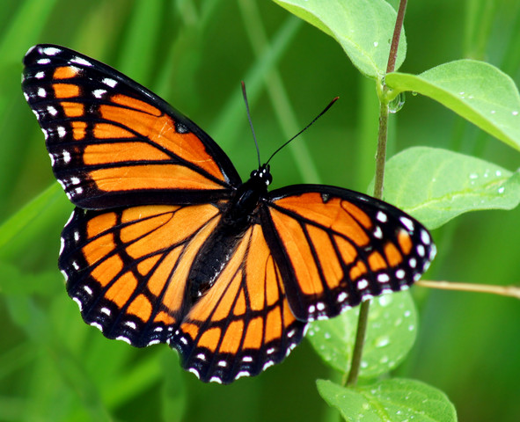
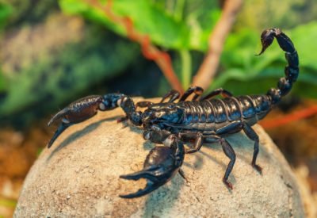
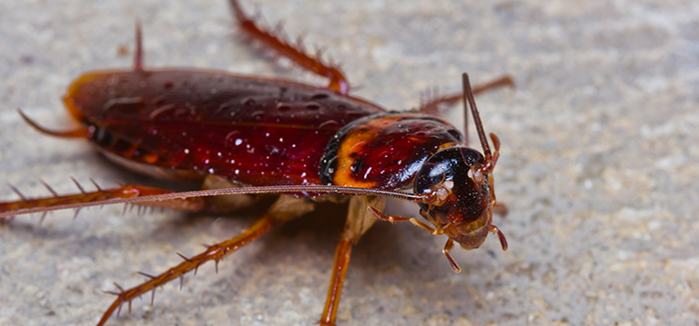
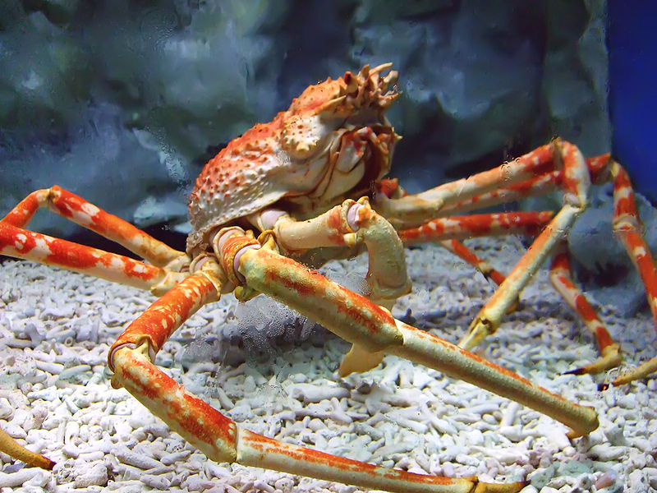
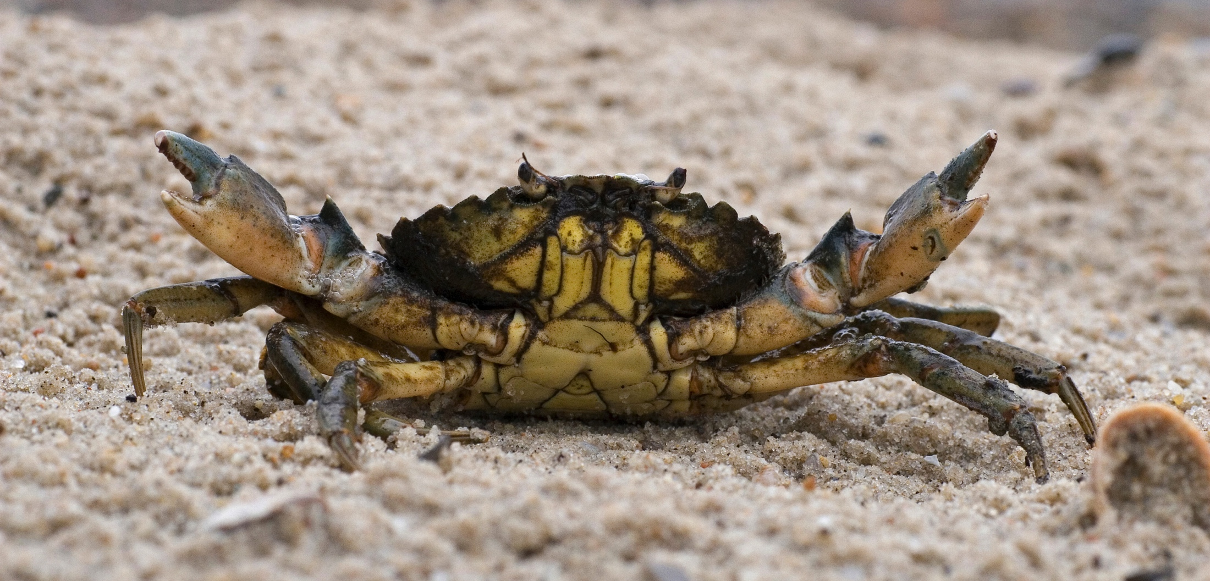
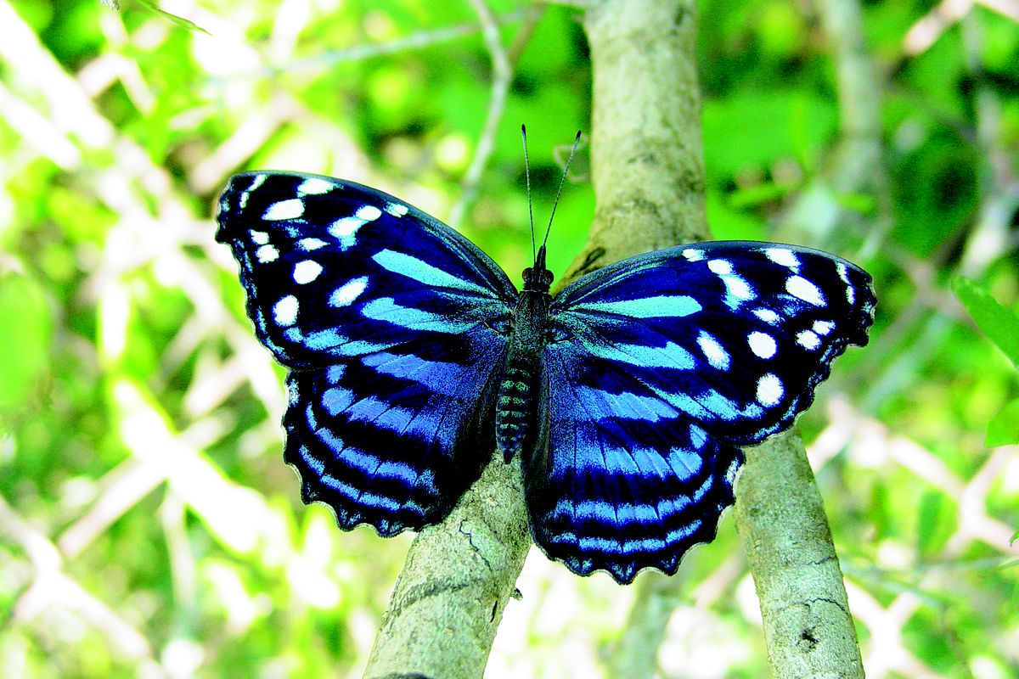
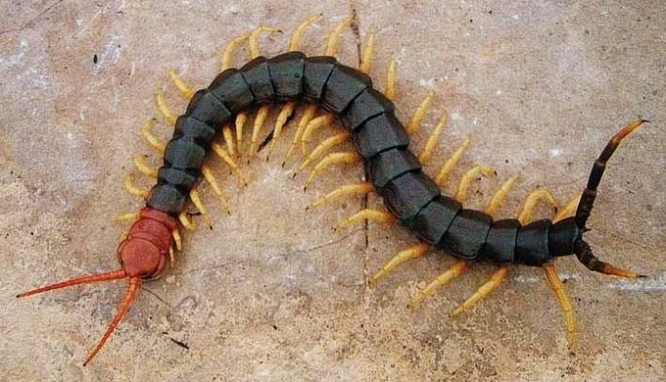
PHYLUM
ARTHROPODA
arthron “joint” + pous “foot”
Notes:
https://www.slideshare.net/mockedicelord/phylum-arthropoda-41750808

Slide 2
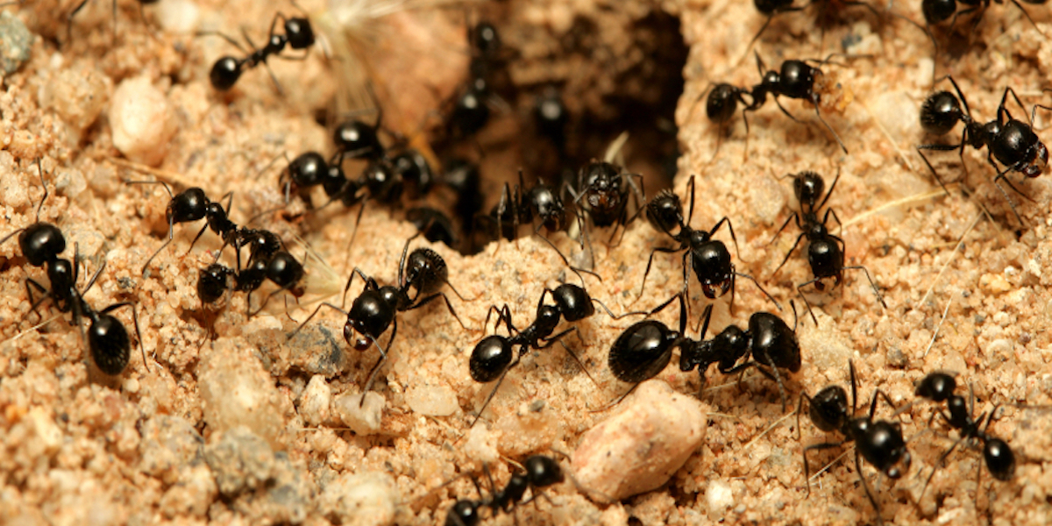
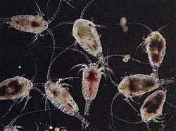
INTRODUCTION
SHEER NUMBERS
More than 83% of all described animal species are arthropods.
About a billion billion (1,000,000,000,000,000,000) insects are alive at any time (bout 160 million insects for each person on Earth).
FUN FACTS
At any moment, there are about 1,000,000,000,000,000 ants alive on the planet. If each ant were half a centimeter long, they could form a chain to circle the Earth 125,000 times.
Tiny crustaceans called copepods, less than a centimeter long, are the most abundant animals in the ocean. They outweigh all the whales on Earth.

Slide 3
HABITAT AND DISTRIBUTION
Throughout their evolution, arthropods have invaded new geographic areas and habitats.
Examples:
The crustacean Gammarus Wilkitzkii makes a living on the underside of the Arctic ice pack, feeding on other crustaceans.
The Yeti Crab live more than a mile beneath the ocean surface in the harsh environment around hydrothermal vents.
Scolopendra Gigantea, the largest centipede species on Earth, lives in the Amazon of South America. It grows to over 30cm long and hunts small mammals, lizards, and frogs.
The Himalayan Jumping Spider lives almost 7km above sea level on the snow-covered slopes of Mount Makalu, east of Mount Everest.
The Melophorus Ants of the Australian desert can withstand extreme heat – temperatures higher than 60°C.
The Wingless Fly is one of the very few land animals native to Antarctica, and 1cm long.

Slide 4
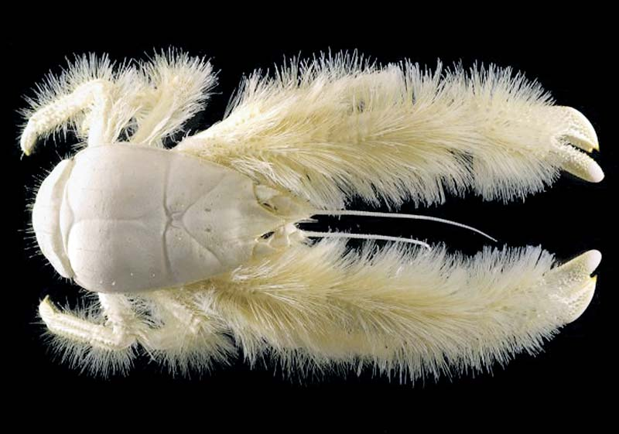
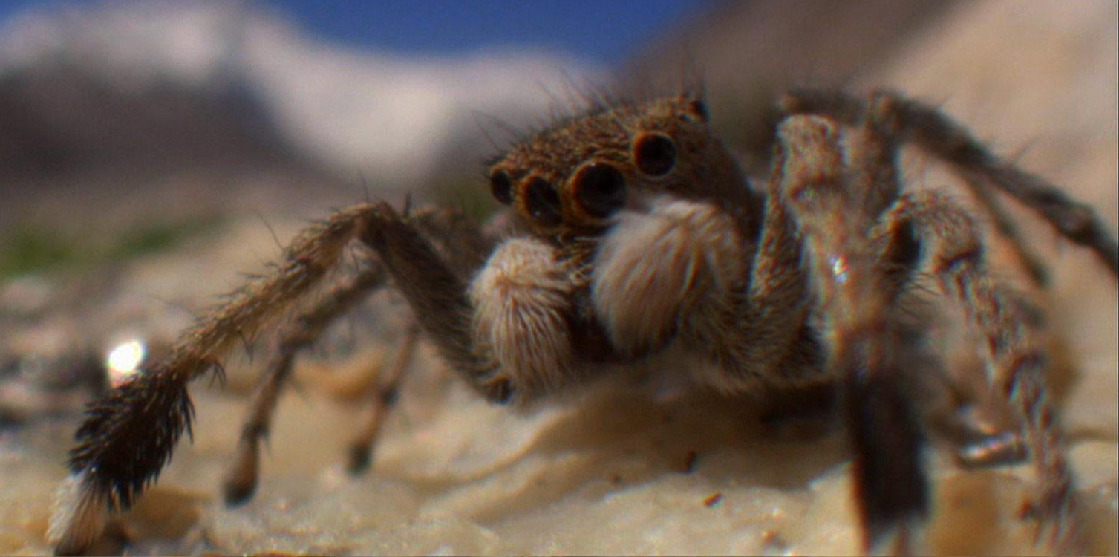
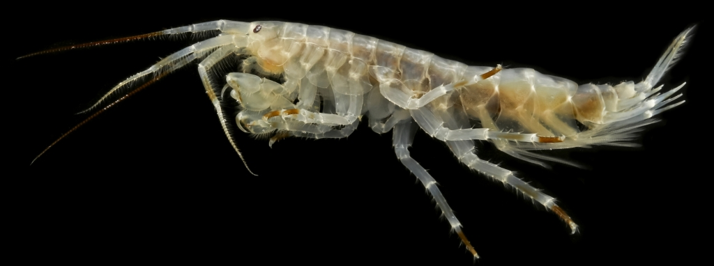
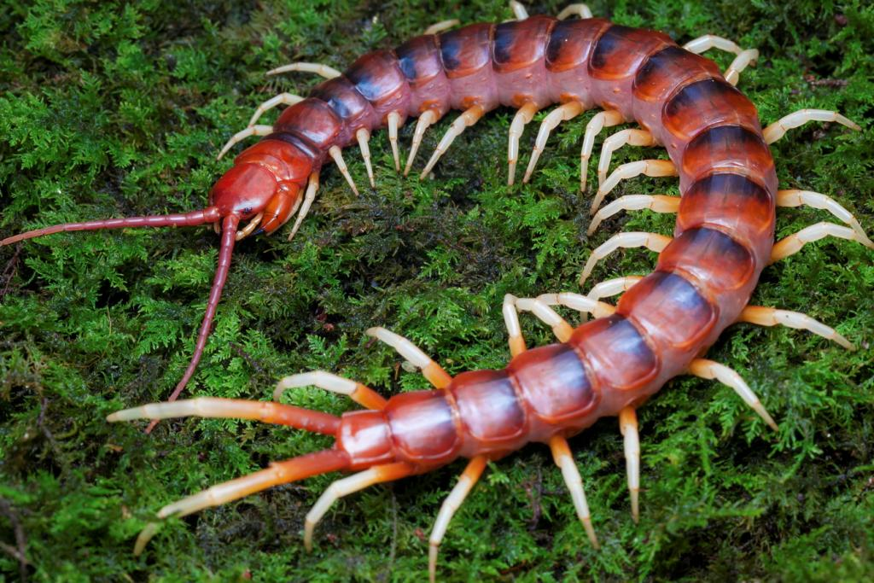
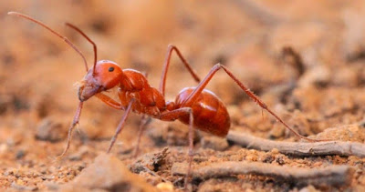
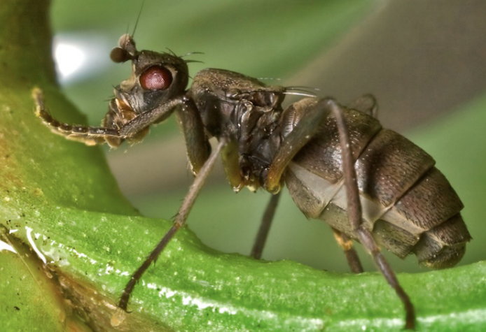
HABITAT AND DISTRIBUTION
Gammarus Wilkitzkii
Yeti Crab
Himalayan Jumping Spider
Melophorus Ant
Wingless Fly
Scolopendra Gigantea

Slide 5
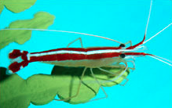
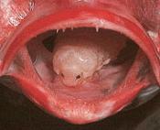
ECOLOGICAL NICHES
Throughout their evolution, arthropods have successfully invaded new ecological niches.
Examples:
Cleaner shrimp run underwater “service stations, where fish come to be cleaned of parasites and old scales by the attending shrimp.
The parasitic crustacean, Cymothoa Exigua, is a freeloader – it lives in a fish’s mouth, attached to the fish’s tongue, and feasts on its blood.

Slide 6
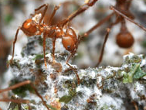
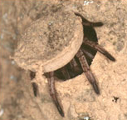
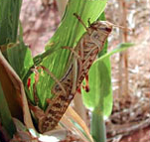
ECOLOGICAL NICHES
Examples:
Leafcutter ant colonies live on communal fungal farms.
Australian trapdoor spiders construct elaborate snares for unsuspecting insects.
The plague locust will join swarms, where the locust swarm will consume almost anything green (including items such as fabric and plastic) and can strip a field bare in minutes.

Slide 7
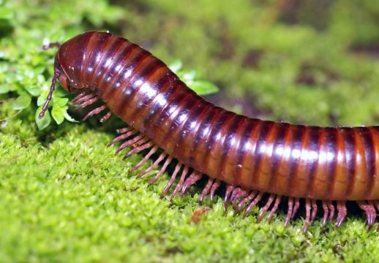
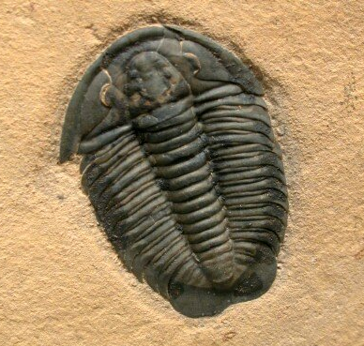
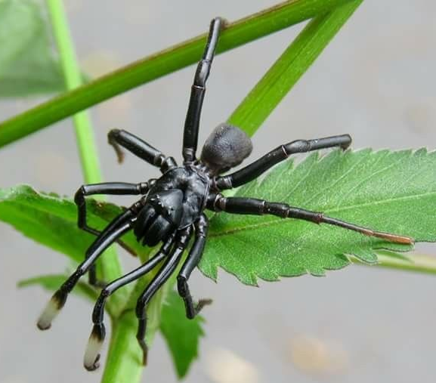
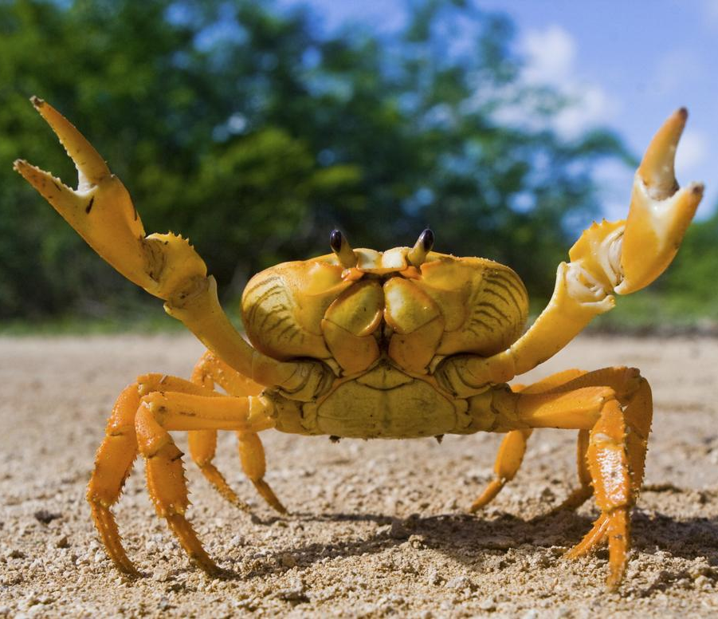
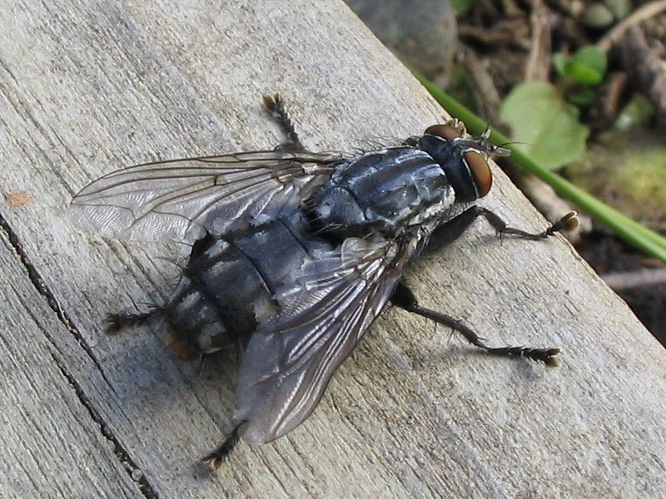
THE FIVE BRANCHES (SUBPHYLUM) OF THE ARTHROPOD (PHYLUM) TREE
Modern arthropods include insects, spiders, centipedes, shrimp, and crayfish.
All arthropods are the descendants of a single common ancestor.
myriapods
trilobites
chelicerates
crustaceans
hexapods
common ancestor
Notes:
https://en.wikipedia.org/wiki/Arthropod
https://evolution.berkeley.edu/evolibrary/article/0_0_0/arthropods_intro_01

Slide 8
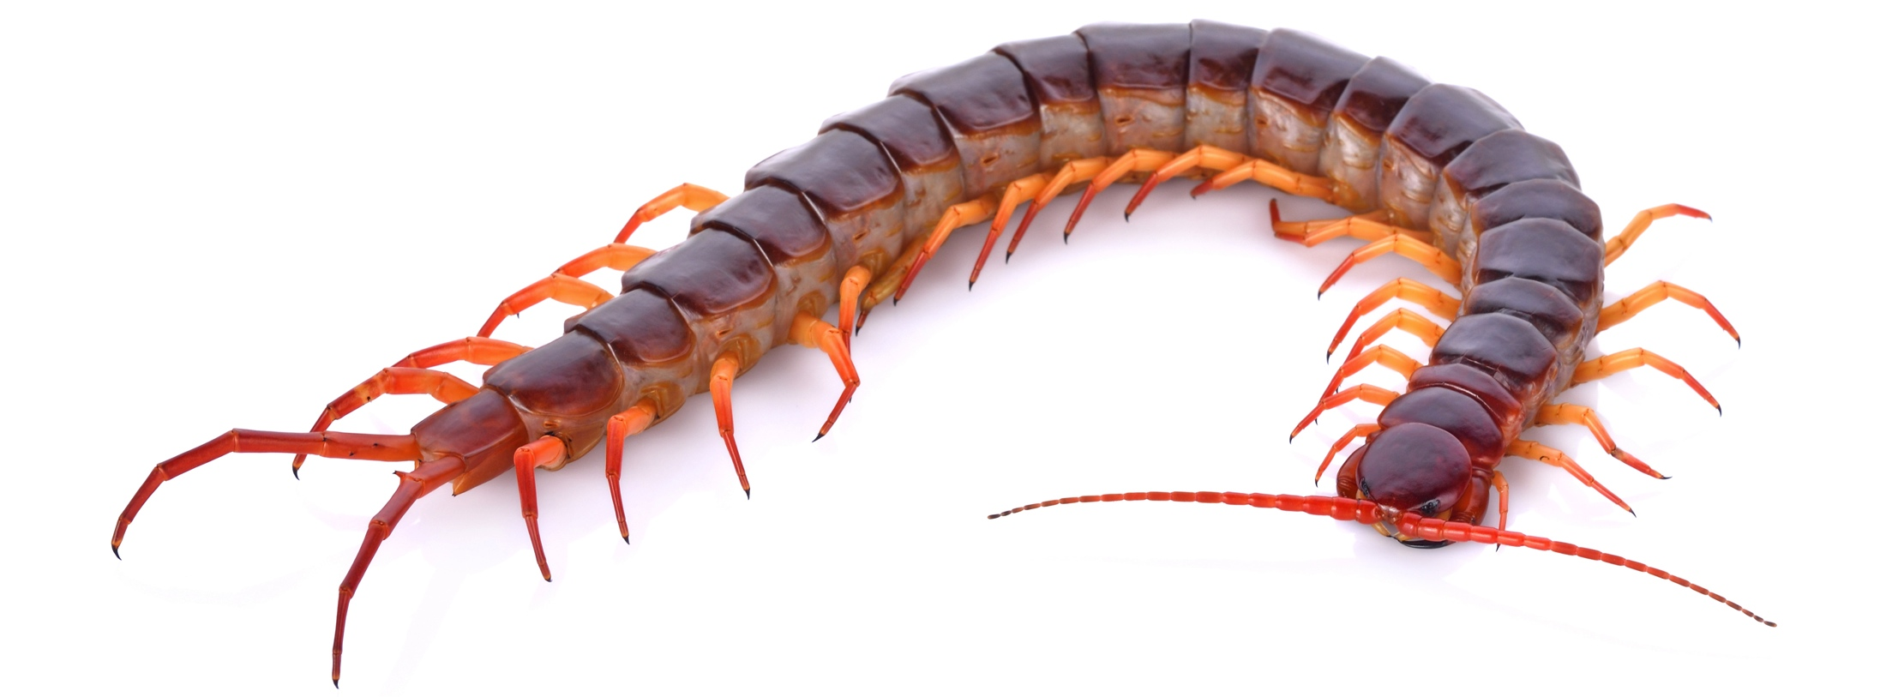
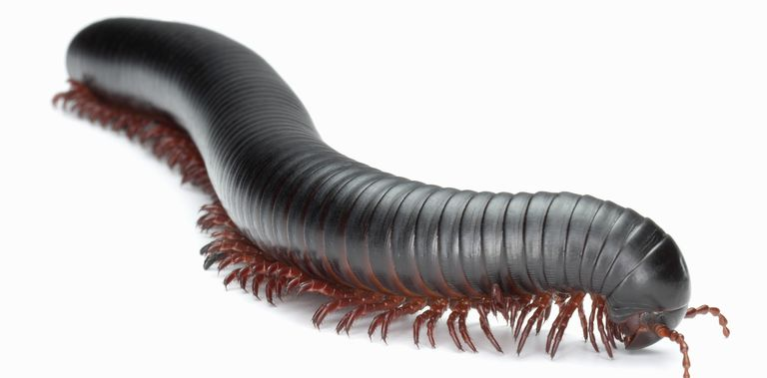
Myriapods Myriapoda = mūrias “ten-thousand” + poda “foot” = “ten-thousand footed”
A body built from a head and long, repeating trunk.
One pair of antennae (number of other appendages on head varies), many limbs on trunk.
Examples of myriapods include centipedes and millipedes.

Slide 9
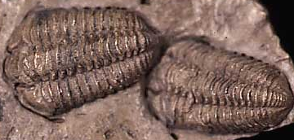
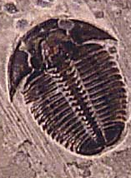
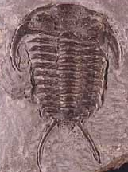
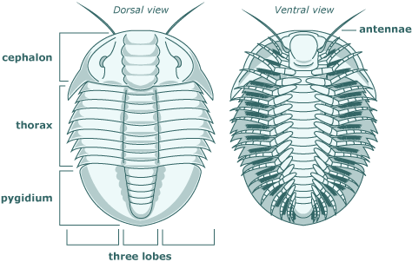
Trilobites Trilobitomorpha = tri “three” + lobos “lobe” + morphi “shape” = “three lobe shape”
An extinct group of arthropods.
The last trilobites went extinct about 245 million years ago, but they are well represented by the fossil record.
A body built from a cephalon, thorax, and pygidium.
A body divided into three lobes, running from head to tail.
One pair of antennae.

Slide 10
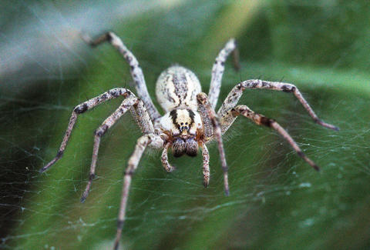
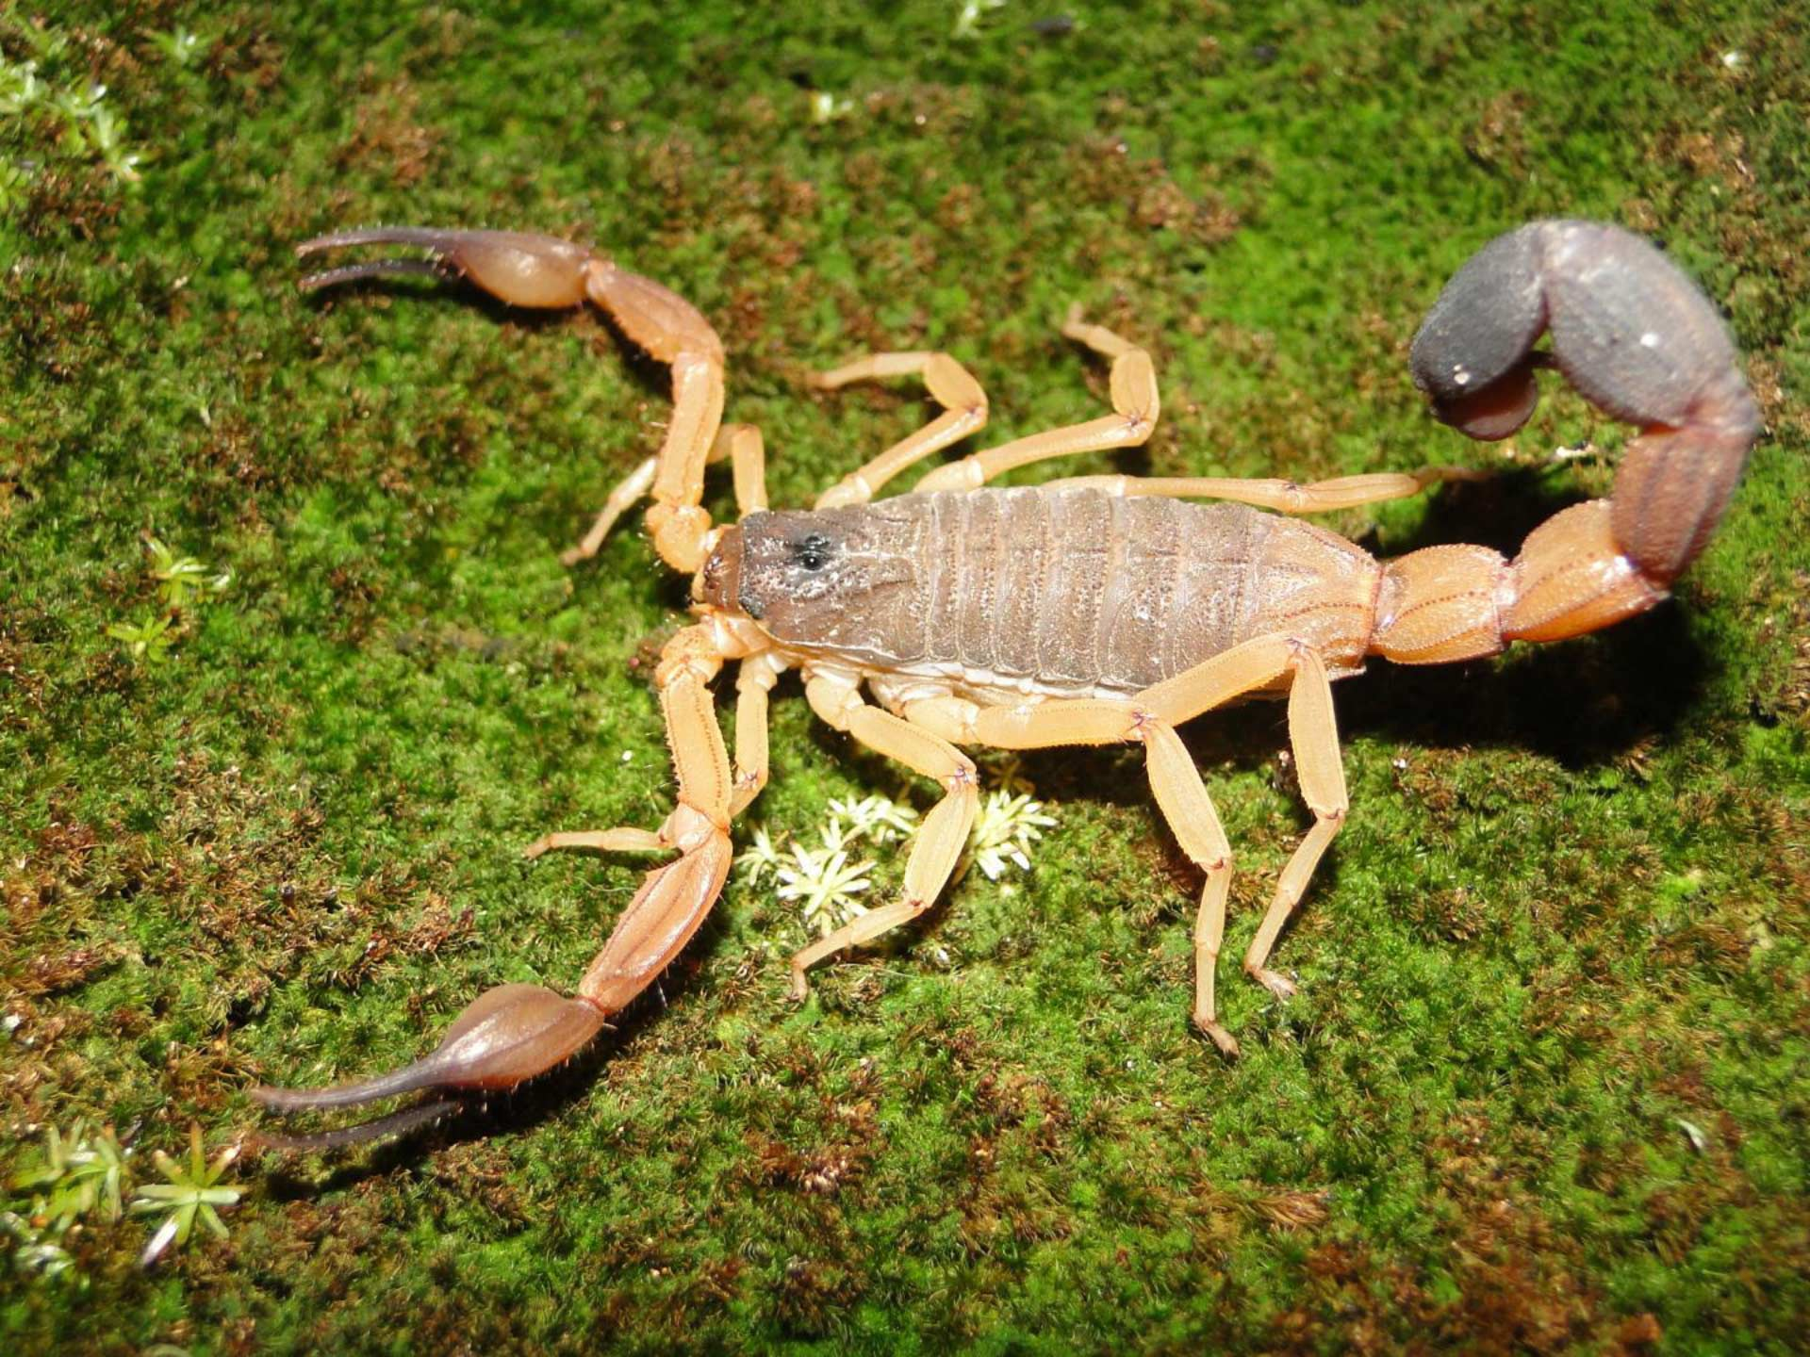
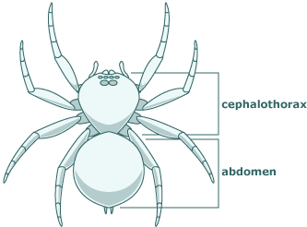
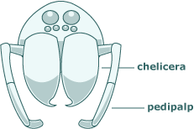
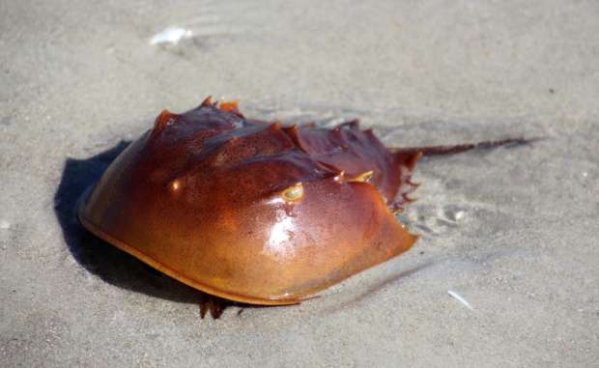
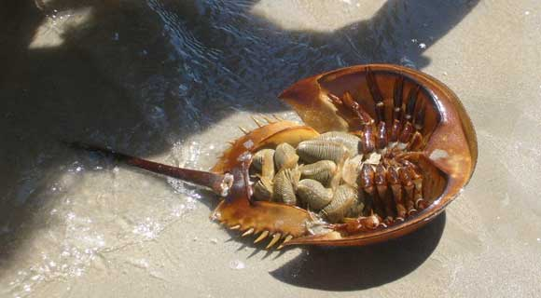
Chelicerates Chelicerata = “claw-horn”
A body divided into a cephalothorax and abdomen.
No antennae, but two pairs of appendages on the anterior cephalothorax (chelicerae and pedipalps), and four pairs of walking legs.
Examples of chelicerates include spiders, scorpions, and horseshoe crabs.

Slide 11
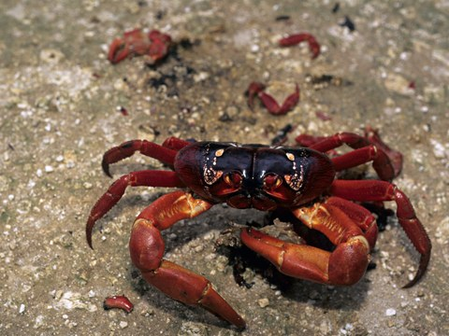
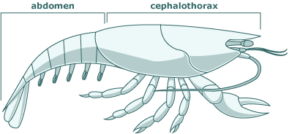
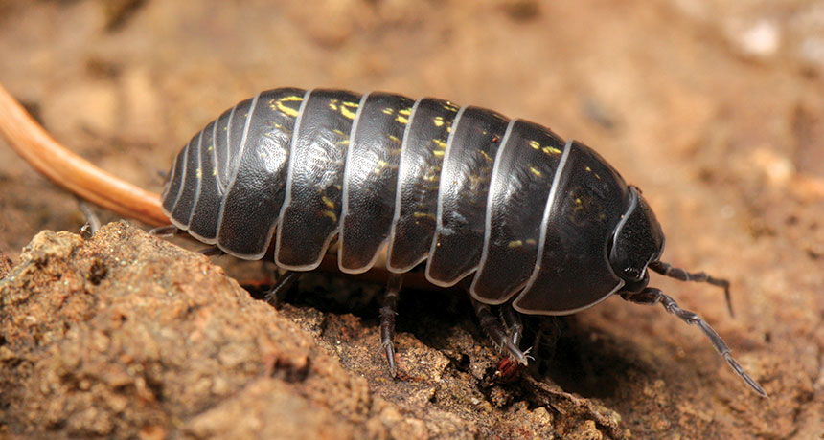
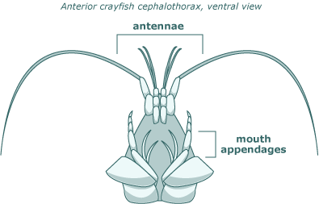
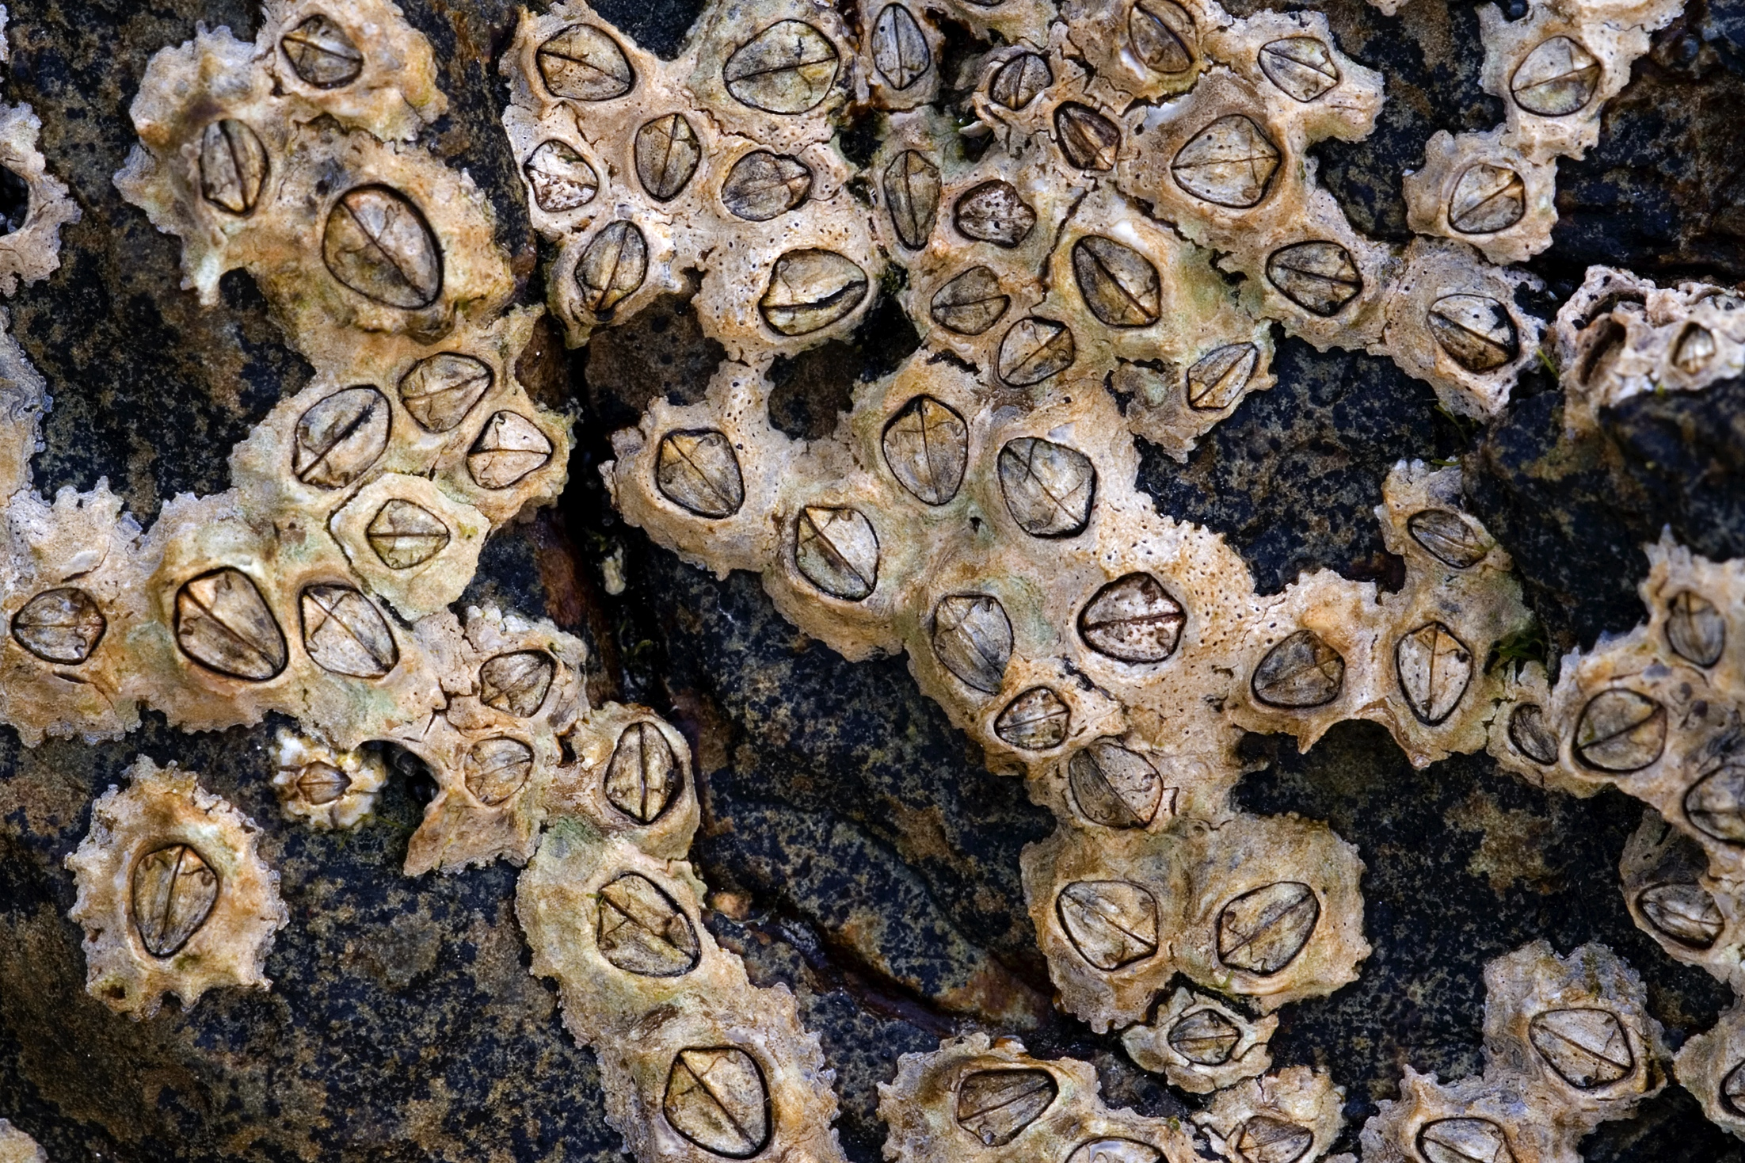
Crustaceans Crūstacea = “crusty shaped”
A body divided into cephalothorax and abdomen.
Two pairs of antennae and three pairs of mouth appendages.
Examples of crustaceans include crabs, pill bugs, and barnacles.

Slide 12
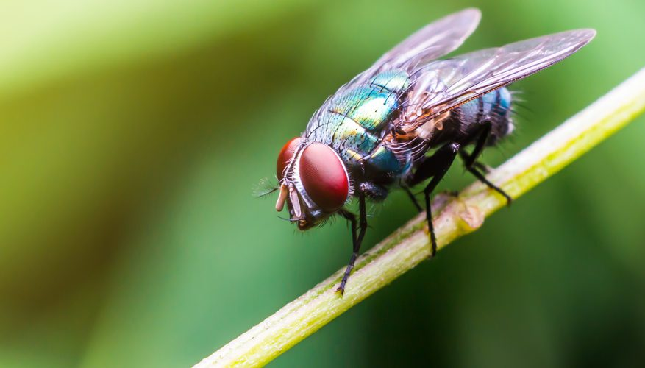
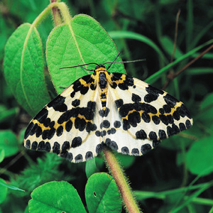
Hexapods / Insects Hexapoda = “six legs” / Insecta = “insects”
A body divided into head, thorax, and abdomen.
One pair of antennae, three pairs of mouth appendages, three pairs of legs on thorax, and often one or two pairs of wings.
Examples of insects include flies, moths and beetles.

Slide 13
SCIENTIFIC CLASSIFICATION (examples)
Taxa (level of hierarchy) | House Centipede (centipede) | Trilobites | Southern Black Widow (spider) | Red-jointed Fiddler Crab (crab) | Big-headed Ground Beetle (beetle)
Kingdom | Animalia (Animals) | Animalia | Animalia | Animalia | Animalia
Phylum Sub-phylum | Arthropoda (Arthropods) Myriapoda (Myriapods) | Arthropoda (Arthropods) Trilobitomorpha (Trilobites) | Arthropoda (Arthropods) Chelicerata (Chelicerates) | Arthropoda (Arthropods) Crustacea (Crustaceans) | Arthropoda (Arthropods) Hexapoda (Hexapods)
Class | Chilopoda (Centipedes) | Due to the fact that trilobites existed over 520 million years ago, becoming extinct before dinosaurs came into existence, there are no specific examples given of this sub-phylum of arthropods. | Arachnida (Arachnids) | Malacostraca (Malacostracans) | Insecta (Insects)
Order | Scutigeromorpha (House Centipedes) |  | Araneae (Spiders) | Decapoda (Crabs, Crayfishes, Lobsters, Prawns, and Shrimp) | Coleoptera (Beetles)
Family | Scutigeridae |  | Theridiidae (Cobweb Spiders) | Ocypodidae (Fiddler Crabs and Ghost Crabs) | Carabidae (Ground Beetles)
Genus | Scutigera |  | Latrodectus (Widow Spiders) | Uca (Fiddler Crabs) | Scarites
Species | Coleoptrata (House Centipede) |  | Mactans (Southern Black Widow) | Crenulata (Mexican Fiddler Crab) | Subterraneus (Big-headed Ground Beetle)
Notes:
https://bugguide.net/node/view/25

Slide 14
SCIENTIFIC CLASSIFICATION (examples)
House Centipede
Big-headed Ground Beetle
Trilobites
Red-jointed Fiddler Crab
Southern Black Widow

Slide 15
INHERITED CHARACTERISTICS
BILATERAL (left/right) SYMMETRY
JOINTED
LEGS/APPENDAGES
SEGMENTED BODY
HARD EXOSKELETON
(external skeleton)
MANY PAIRS OF LIMBS
most arthropods display all five of these characteristics – traits inherited from their common ancestor

Slide 16
Bilateral Symmetry
Many animals have a body form that is symmetrical, meaning that it could be divided into matching halves by drawing a line down the center.
Arthropods are built like humans are; the right half of an arthropod is a mirror image of its left half — this is called symmetry.
Other animals have radial symmetry / are not symmetrical at all, meaning that their bodies cannot be divided into similar halves with a straight line.

Slide 17
Segmented Body
At some point in their lives, all arthropods have bodies that are internally and externally segmented.
These segments piggyback on one another, like a series of cars in a train.
Each body segment tends to repeat the same suite of structures (for example, a pair of legs, a set of breathing organs, and a set of nerves), often with slight variations down the length of the animal.
Usually, sets of segments are grouped into a larger unit, such as the abdomen.

Slide 18
Hard Exoskeleton (external skeleton)
The bodies of arthropods are supported, not by internal bones, but by a hardened exoskeleton made of chitin (a fibrous substance consisting of polysaccharides).
It is produced by the "skin" and then hardens into a protective outer-covering.
This exoskeleton provides protection and prevents water loss.
In order to grow, all arthropods must shed the exoskeleton and produce a new, larger one.
This process is also known as ‘molting’ or ‘shedding’.
lobster’s exoskeleton
lobster without exoskeleton

Slide 19
Jointed Legs / Appendages
Having a hard exoskeleton introduces a problem for arthropods: flexibility.
Evolution solved this problem with joints.
All arthropods (arthro = joint, pod = foot) have jointed limbs.
In most of the leg, the exoskeleton is hard, but at the joints it is softer and bendable, allowing movement.
The limb can be controlled by contracting muscles connected to the exoskeleton on both sides of the joint.
joints

Slide 20
Many Pairs of Limbs
The ancestral arthropod had many body segments with one pair of limbs on each segment.
All arthropods inherited multiple limbs from that ancestor.
In many arthropods, some limbs have been lost completely as they evolved to be smaller and smaller, while others have evolved into new shapes.
E.g. Crayfish have limbs specialized for different functions.
many limbs – many functions

Slide 21
CONCLUSION
They have been around for more than 500 million years and are still evolving.
They live on Earth in overwhelming numbers.
They have come in all shapes and sizes.
They have evolved to fill a variety of ecological niches (from tiny internal parasites to giant bird-eating predators).
The main reason for their success is their evolution.
They evolved from the main arthropod phylum to their five sub-phlyums.
They inherited the traits/characteristics from a common ancestor that further enabled them to survive, reproduce, and flourish.
Notes:
https://www.slideshare.net/mockedicelord/phylum-arthropoda-41750808

Slide 22
QUIZ
Proceed to Kahoot.
https://kahoot.it/
Await further instructions.
Have fun!

