Slide 1
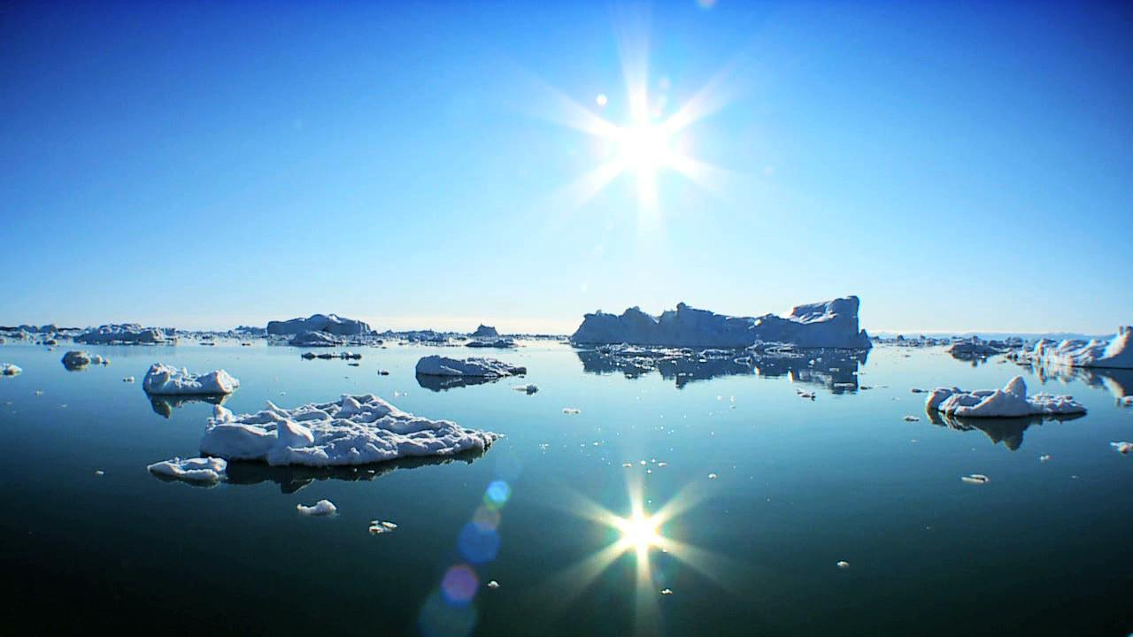
TOPIC 4.4 – CLIMATE CHANGE
Teacher: Mrs. Barnes or Miss Andrea

Slide 2
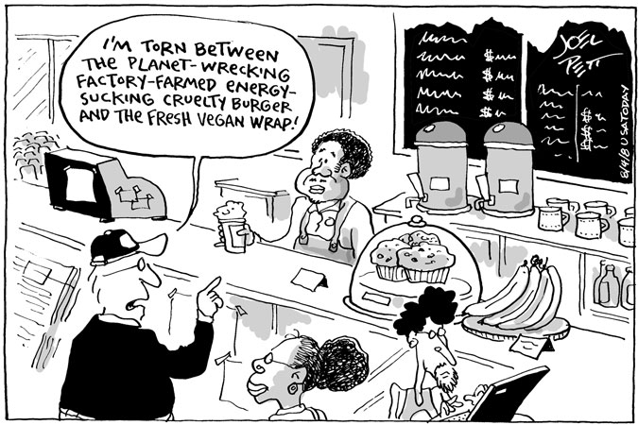

Slide 3
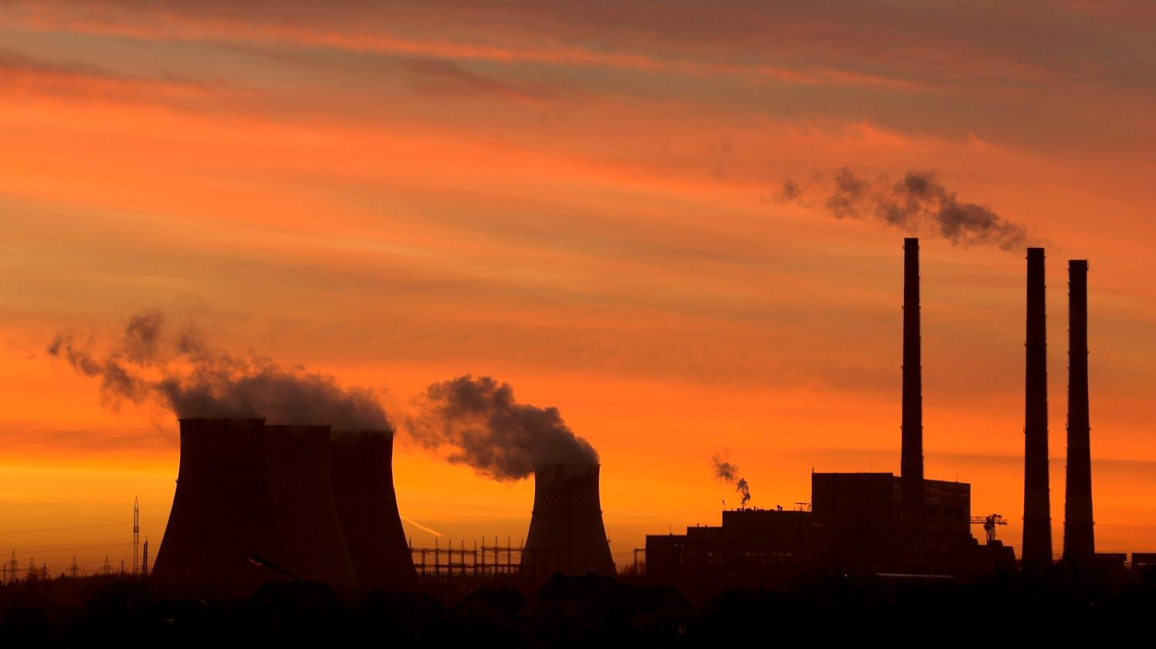
4.4 – The Science Behind Climate Change
Today’s Activities:
Play “Fact or Fiction”
Overview of the Greenhouse Effect & Greenhouse Gases
Global Climate Change Mini-Research Activity

Slide 4
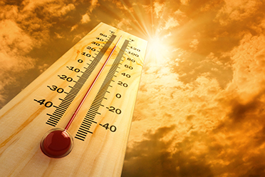
Let’s Play – “Fact or Fiction!”
Let’s look at 6 statements:
Read carefully and decide if these statements are true (”fact”) or false (“fiction”) and fill in your tally sheet. Make sure to provide support for your point of view!

Slide 5
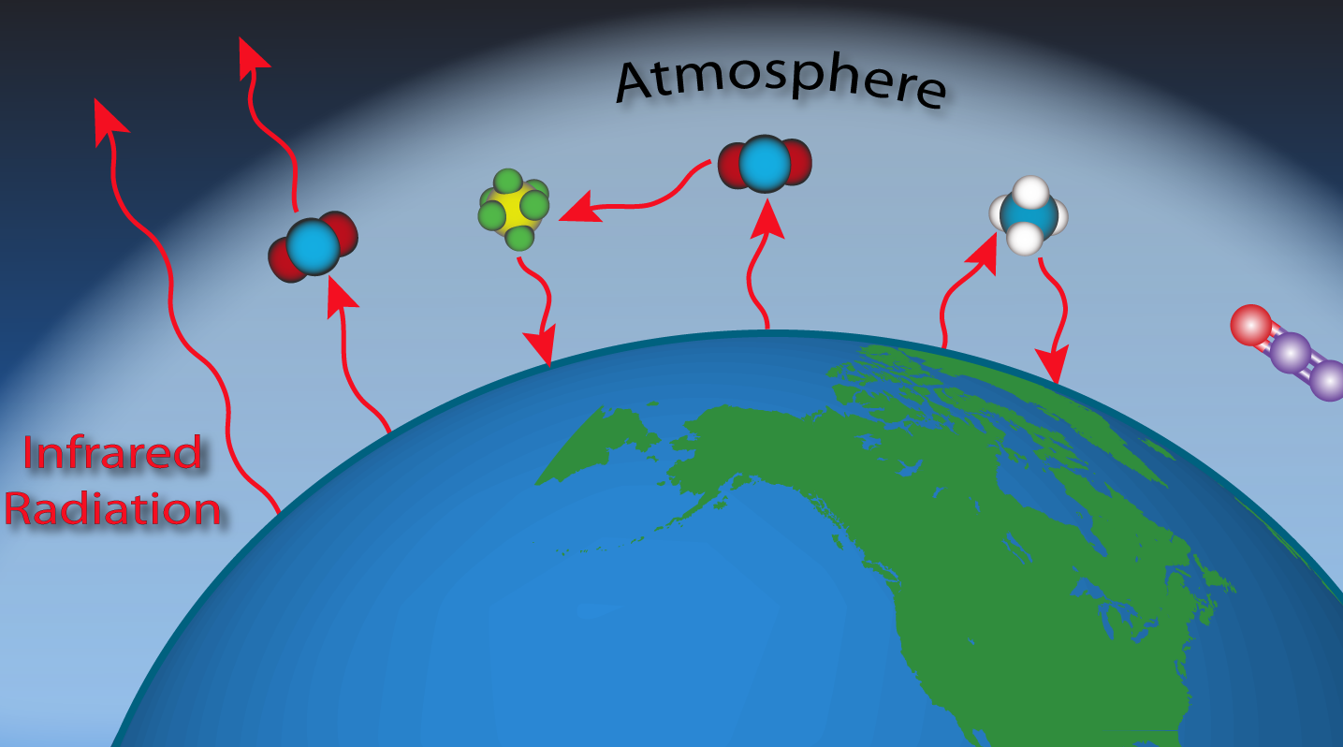
IB BIO – 4.4
Greenhouse gases are those that absorb long wave radiation and re-emit it as heat energy (infrared radiation). Origins of greenhouse gases include natural processes and human activity. In the atmosphere, carbon dioxide and water vapour are the most abundant.
5
Understandings
U1: Carbon dioxide and water vapor are the most significant greenhouse gases.
Key Terms
Greenhouse Gases
Water Vapour
Carbon Dioxide
Methane &
Nitrogen Oxides
http://www.esrl.noaa.gov/gmd/ccgg/images/greenhouse2.png

Slide 6
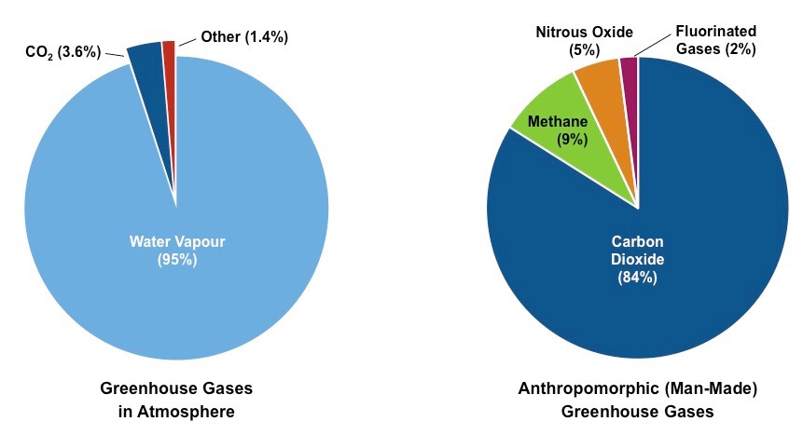
6
Proportion of Greenhouse Gases (Natural vs Anthropomorphic)
http://ib.bioninja.com.au/standard-level/topic-4-ecology/44-climate-change/greenhouse-gases.html

Slide 7
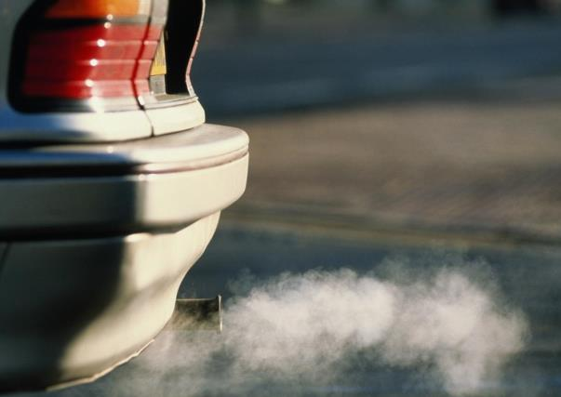
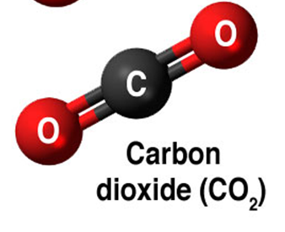
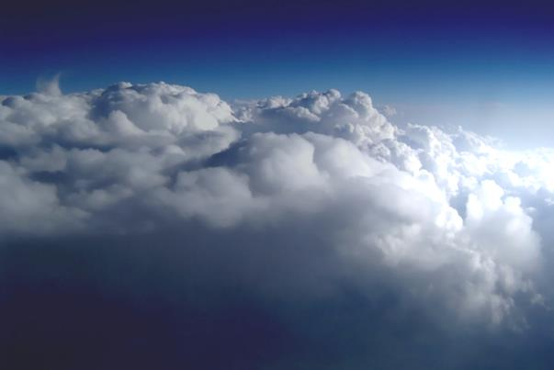
IB BIO – 4.4
Carbon dioxide is released into the atmosphere through cell respiration and the burning of fossil fuels.
It is removed by photosynthesis.
Water vapour is added to the atmosphere through evaporation (e.g. oceans) and transpiration.
It is removed via percipitation (rain, snow, hail, etc.).
7
Understandings
U1: Carbon dioxide and water vapor are the two most significant greenhouse gases.
Key Terms
Greenhouse Gas
Water Vapour
Carbon Dioxide
http://www.esrl.noaa.gov/gmd/ccgg/images/greenhouse2.png

Slide 8
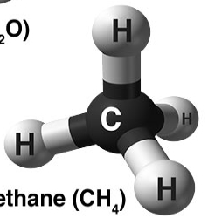
IB BIO – 4.4
Other greenhouse gases include methane and nitrogen oxides. They are present in lower concentration and so have a lesser impact.
8
Understandings
U2: Other gases including methane and nitrogen oxides have less impact.
Key Terms
Greenhouse Gas
Methane
Nitrogen Oxides
Methane is emitted from:
Waterlogged habitats
Landfills
Fossil fuel extraction
Melting polar ice
Nitrous oxides are released by:
Bacteria in some habitats
Agriculture
Vehicle exhausts
http://climate.nasa.gov/system/internal_resources/details/original/249_Causes-greenhouse-gas-molecules-cropped-more-55.jpg

Slide 9
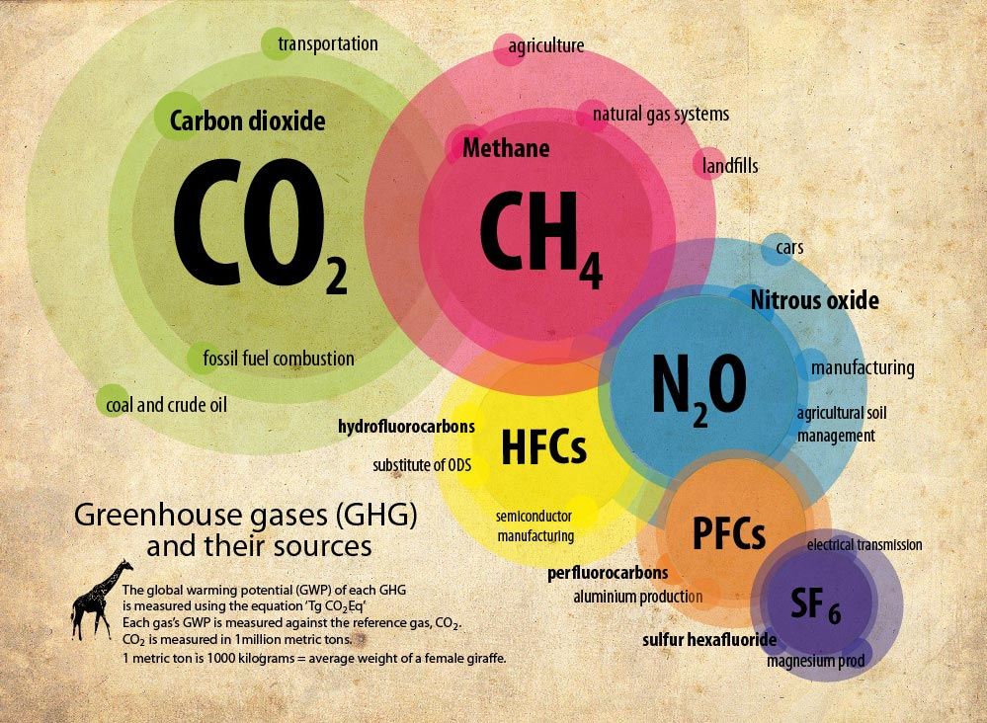
IB BIO – 4.4
9
Understandings
U2: Other gases including methane and nitrogen oxides have less of an impact.
Key Terms
Greenhouse Gas
Anthropogenic
http://www.sabc.co.za/

Slide 10
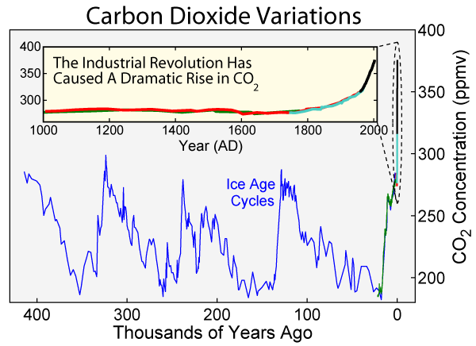
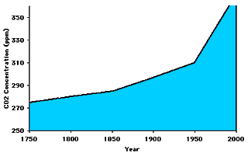
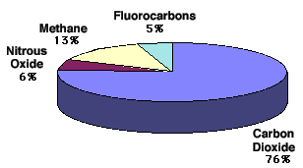
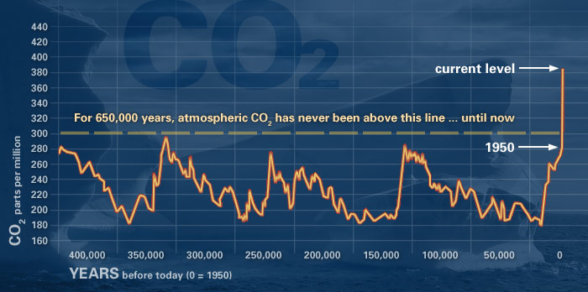
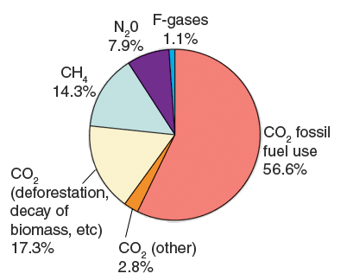

Slide 11
IB BIO – 4.4
Factors Determining Their Impact:
Understandings
U3: The impact of a gas depends on its ability to absorb long-wave radiation as well as on its concentration in the atmosphere.
 | Atmospheric Lifetime | *Global Warming Potential (GWP) | Concentration of the gas (p.p.m. or p.p.b.)
Carbon Dioxide (CO₂) | 50-200 years | 1 | 400 p.p.m. (0.04 %)
Methane (CH₄) | 12 years | 21 | 1700 p.p.b. (0.00017 %)
Nitrous Oxide (N₂0) | 114 years | 289 | 320 p.p.b. (0.000032 %)
Key Terms
Greenhouse Gas
Anthropogenic
*Global warming potential over 100 year lifetime
Fact: Greenhouse gases make up less than 1 % of the Earth’s atmosphere.
Fact: The concentration of a gas is determined by its rate of release and persistence within the atmosphere.
Fact: Water vapor remains in the atmosphere for short periods only (1-5 days).

Slide 12
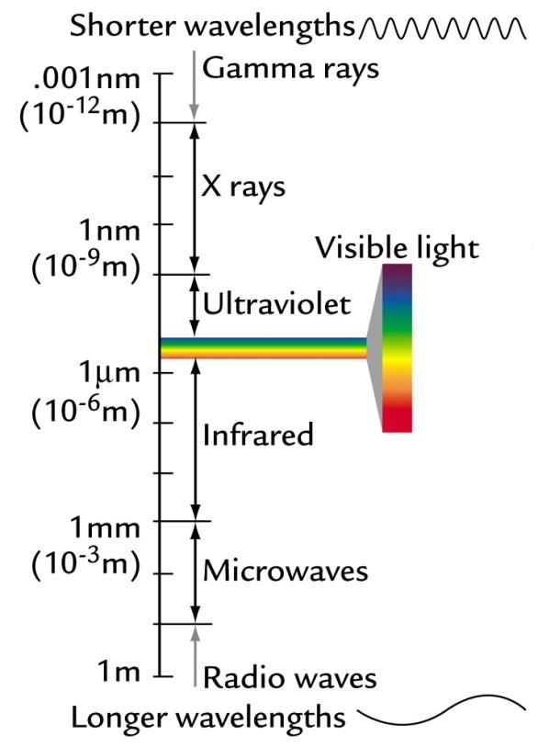
IB BIO – 4.4
There are two factors that affect the impact of a greenhouse gas:
Its ability to absorb long wave radiation
Its concentration in the atmosphere
Long wave radiation is usually in the form of infrared radiation.
This radiation is also known as heat radiation.
12
Understandings
U3: The impact of a gas depends on its ability to absorb long wave radiation as well as on its concentration in the atmosphere.
Key Terms
Long-wave Radiation
http://www.atmosedu.com/Geol390/figures/Ch2/figure%2002-01.jpg

Slide 13
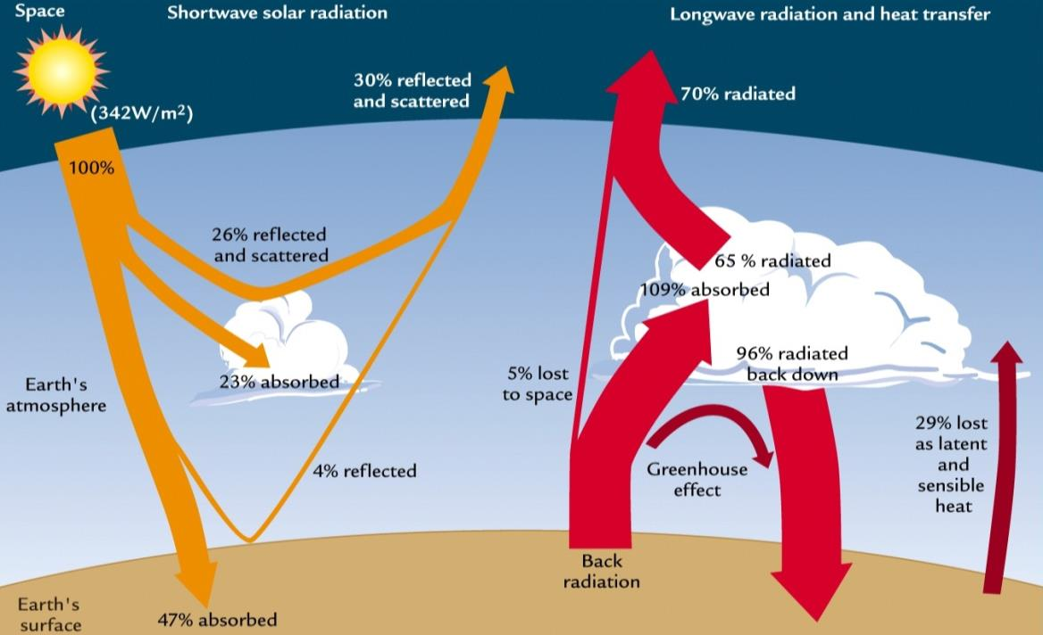
IB BIO – 4.4
The Earth’s surface absorbs short-wave radiation (UV) from the sun and re-emits it as longer wavelength, mostly infrared radiation.
13
Understandings
U4: The warmed Earth emits longer wavelength radiation (heat).
Key Terms
short-wave radiation
Long-wave radiation
https://zolushka4earth.files.wordpress.com/2010/08/radiation-form-sun-and-earth.jpg

Slide 14
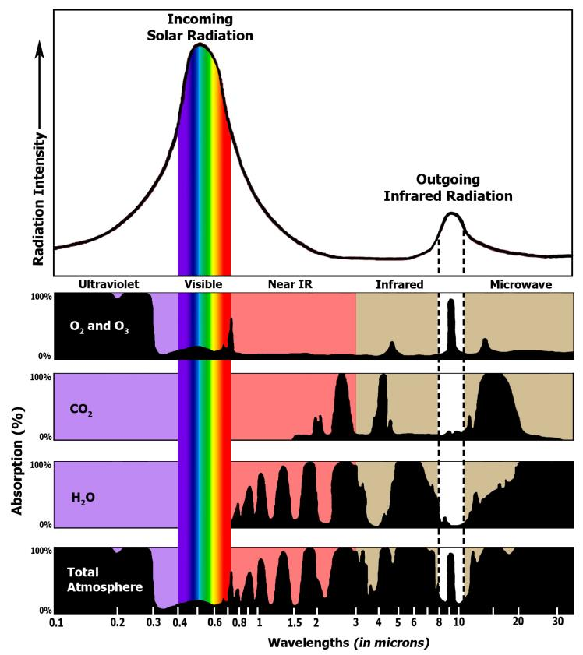
IB BIO – 4.4
Each greenhouse gas is able to absorb specific wavelengths of radiation.
Solar radiation is short wave and passes through them.
Greenhouse gases absorb the longer wave radiation that is re-emitted by the Earth.
The re-emitted wavelengths are between ~5-70nm.
14
Understandings
U5: Longer wave radiation is absorbed by greenhouse gases which retains the heat in the atmosphere.
Key Terms
Greenhouse Effect
http://www.ces.fau.edu/nasa/images/Energy/GHGAbsoprtionSpectrum.jpg

Slide 15
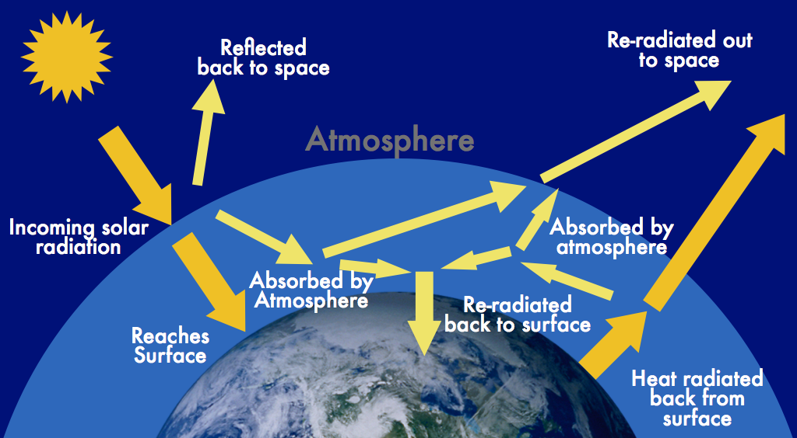
IB BIO – 4.4
The ability of greenhouse gases to absorb longwave radiation has the overall effect of retaining heat in the Earth’s atmosphere. This effect is known as the greenhouse effect.
15
Understandings
U5: Longer wave radiation is absorbed by greenhouse gases which retains the heat in the atmosphere.
NASA Video Clip: https://www.youtube.com/watch?v=ZzCA60WnoMk
Key Terms
Greenhouse Effect
http://ypachecoapes.weebly.com/uploads/2/3/4/3/23430144/806809545.png

Slide 16
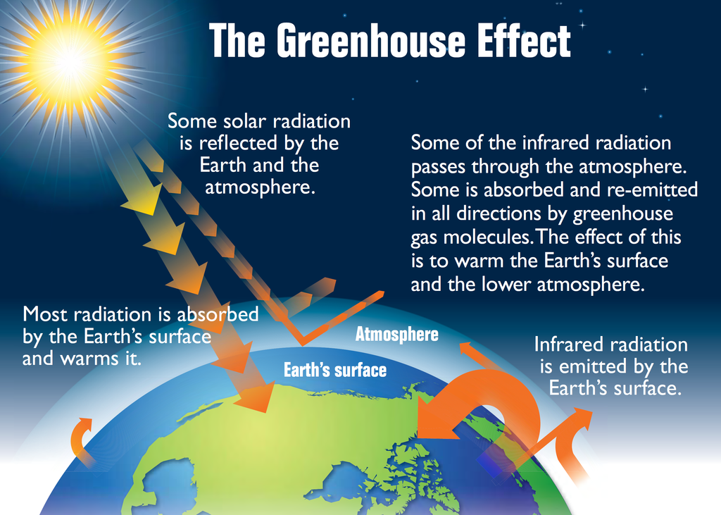
NASA Video Clip: https://www.youtube.com/watch?v=ZzCA60WnoMk

Slide 17
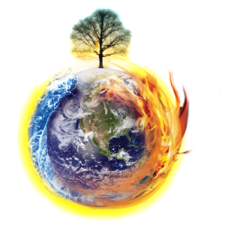
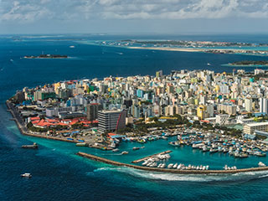
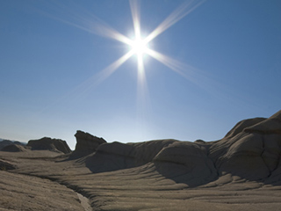
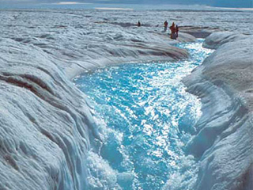
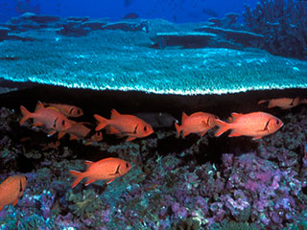
The Many Effects of Climate Change:
Rising sea levels: approximately 8 inches in the last century
Rising global temperatures: most of the warming occurred in the past 35 years, with 15 of the 16 warmest years on record occurring since 2001.
Warming Oceans: ocean temperatures have increased by about 0.2°F (0.11°C) per decade. This warming has occurred from the surface to a depth of about 2,300 feet (700 meters), where most marine life thrives
Shrinking ice sheets: The Greenland and Antarctic ice sheets have decreased in mass.
Extreme weather events
Declining Arctic ice
Decreased snow cover
Glacial retreat
* Ocean acidification

Slide 18
IB BIO – 4.4
18
VIDEOS
MinuteEarth: How Do Greenhouse Gases Work?
TestTube101: What is Greenhouse Gas?
FuseSchool: What is The Natural Greenhouse Effect?
MUST SEE: Watch “An Inconvenient Truth” in the library
A 2006 documentary that sparked a global movement against the climate crisis a decade ago. (1h 58 min)

Slide 19
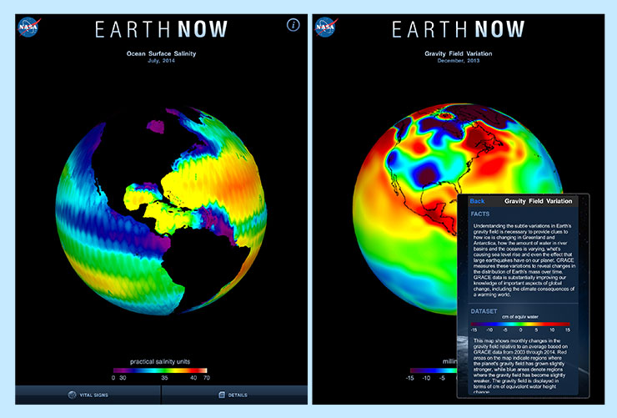
APPS
NASA’s “Earth Now” app displays real-time global satellite data of your planet’s vital signs. This 3D app can be your go-to source for carbon dioxide conditions, gravity anomalies, ozone levels over Antarctica and more.
https://climate.nasa.gov/earth-apps/

Slide 20
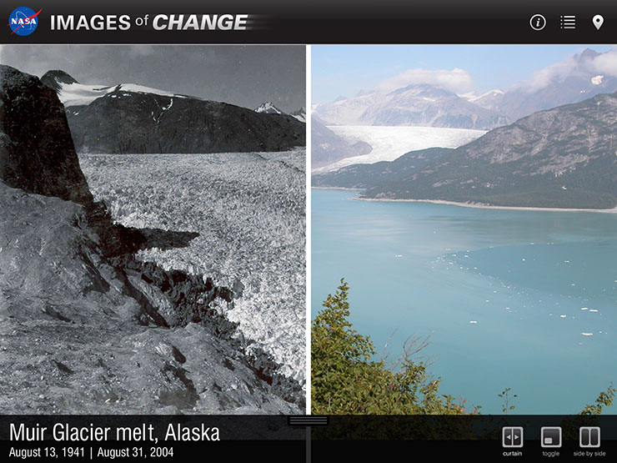
APPS
Human activities, a changing climate and natural disasters are rapidly altering the face of our planet. Both NASA satellites and ground photographers have captured these changes in the form of eye-opening before-and-after images of phenomena ranging from glacial retreat to urbanization. Each image can be viewed side-by-side or with an interactive slider and in context on a world map.
https://climate.nasa.gov/earth-apps

Slide 21
GAME
Climate Literacy
Essential Principles Challenge (Library)
Climate System | Causes of Change | Effects of Change
10 points | 10 points | 10 points
20 points | 20 points | 20 points
30 points | 30 points | 30 points
40 points | 40 points | 40 points
50 points | 50 points | 50 points
60 points | 60 points | 60 points
70 points | 70 points | 70 points
80 points | 80 points | 80 points
90 points | 90 points | 90 points
100 points | 100 points | 100 points

Slide 22
IB BIO – 4.4
22
Research these topics and be prepared to do a mini-presentation tomorrow:
Outline the factors that affect the impact of a greenhouse gas. How do ghgs affect our atmosphere?
Explain the greenhouse effect (both with and in the absence of greenhouse gases).
Define climate change. How does it relate to the Industrial Revolution?
Choose one of the common misconceptions or “fictional” statements from our first activity and research the topic.
You Teach!

Slide 23
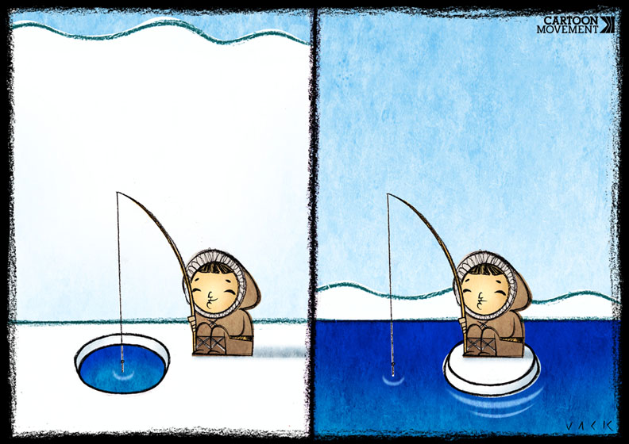
IB BIO – 4.4
23
Take a Look at these Websites:
Visualizing the Invisible Drivers of Climate Change: NASA shows how carbon dioxide moves within the atmosphere.
https://www.nytimes.com/2016/12/16/science/carbon-dioxide-satellite.html?rref=collection%2Fsectioncollection%2Fscience&action=click&contentCollection=science&region=rank&module=package&version=highlights&contentPlacement=2&pgtype=sectionfront&_r=1
2. Evidence of Climate Change
https://climate.nasa.gov/evidence/
The Intergovernmental Panel
on Climate Change (IPCC)
https://www.ipcc.ch/report/ar5/
Useful Links

Slide 24
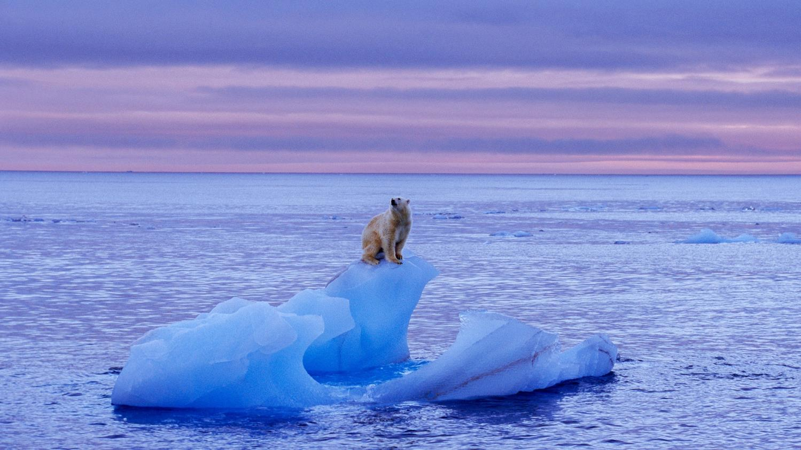
4.4 – B – Global Warming

Slide 25
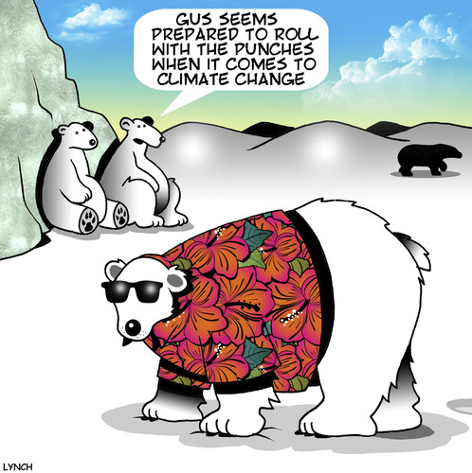
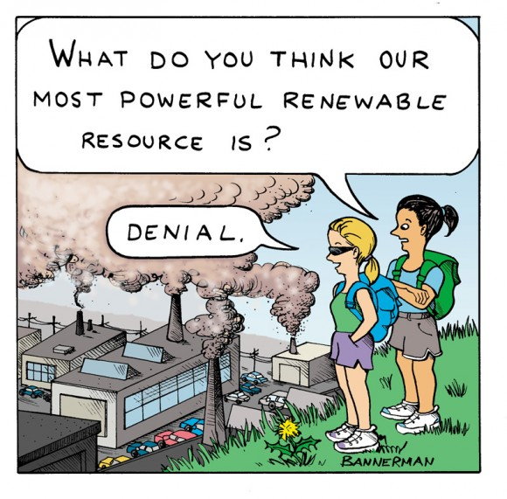

Slide 26
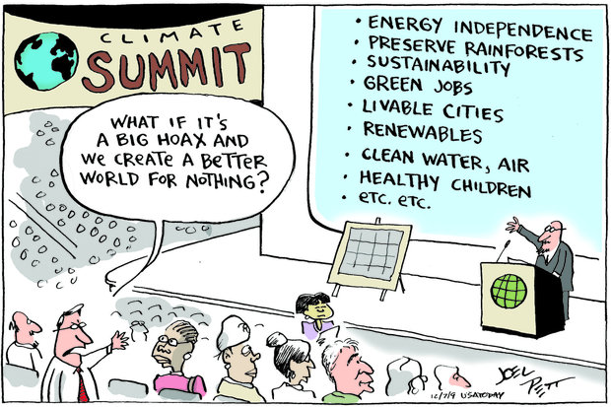

Slide 27
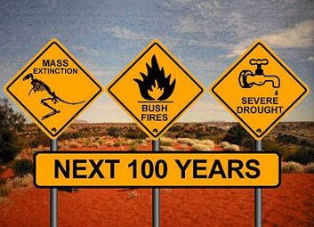
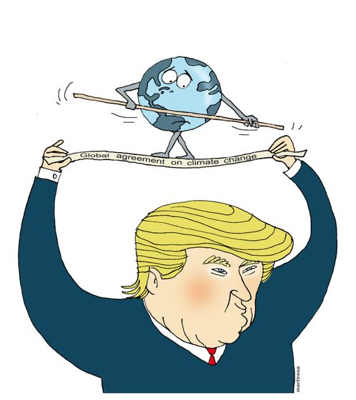
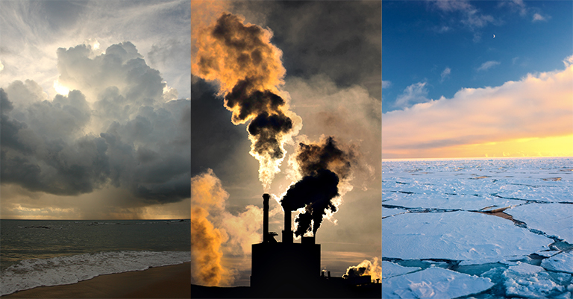
Today’s Activities:
Group Mini-Presentations
Overview of Global Warming
Effects & Evidence of Global Warming

Slide 28
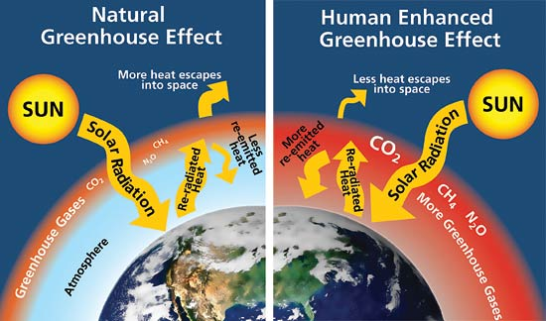
IB BIO – 4.4
Because of greenhouse gases, Earth’s temperature is warmer than it would be otherwise. However, if the concentration of gases increases, it follows that overall temperatures will increase as well.
28
Understandings
U6: Global temperatures and climate patterns are influenced by concentrations of greenhouse gases.
Key Terms
http://images.slideplayer.com/18/5699805/slides/slide_10.jpg

Slide 29
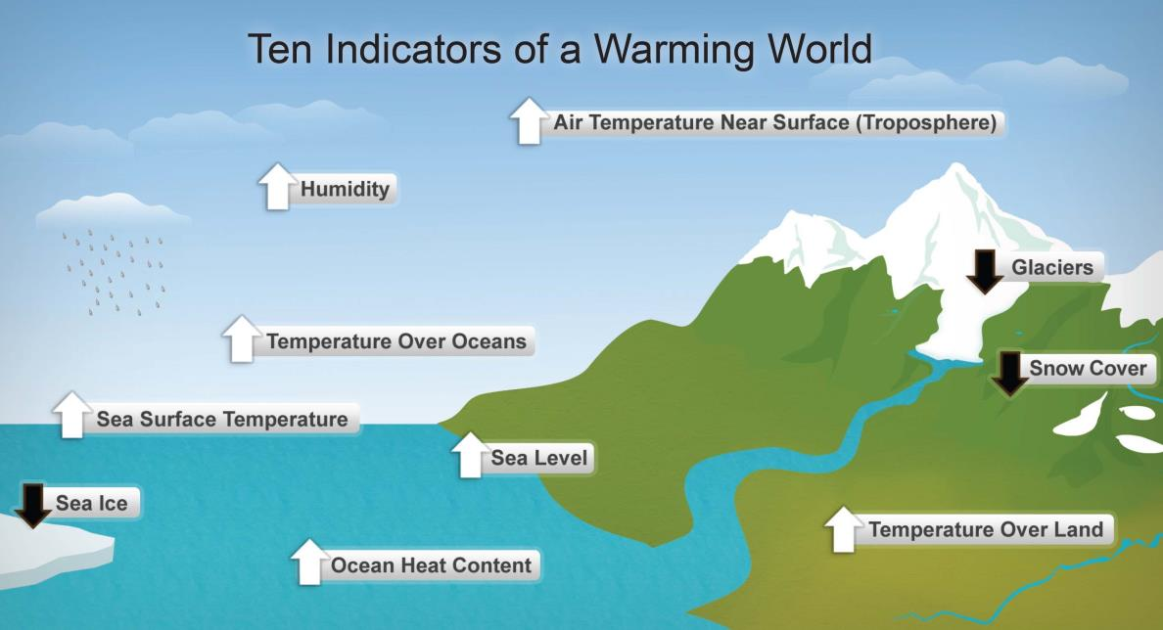
IB BIO – 4.4
Increases in temperature affect climates around the world differently. Some changes that can be observed include those shown in the diagram below:
29
Understandings
U6: Global temperatures and climate patterns are influenced by concentrations of greenhouse gases.
Key Terms
http://www.climate-change-guide.com/images/ten-indicators-of-global-warming.jpg

Slide 30
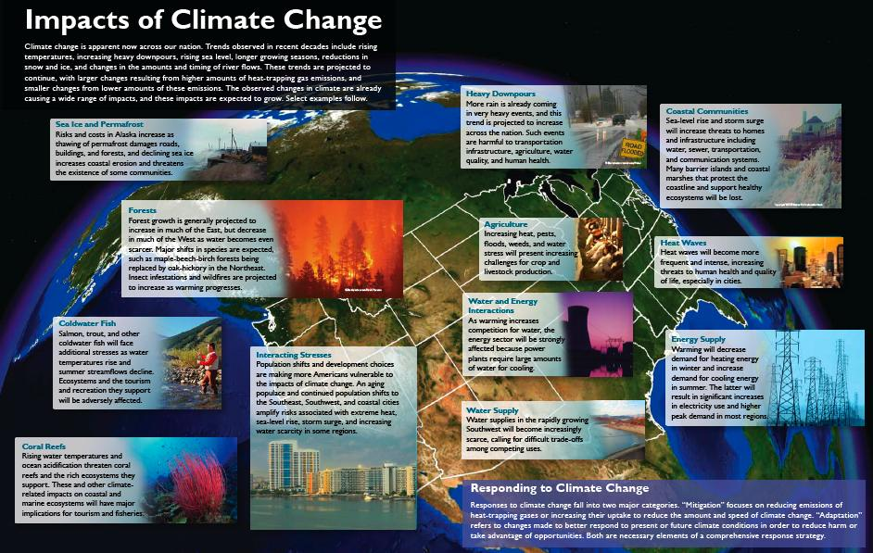
http://courses.tlt.psu.edu/course/bio12/module08/CCimpacts.jpg

Slide 31
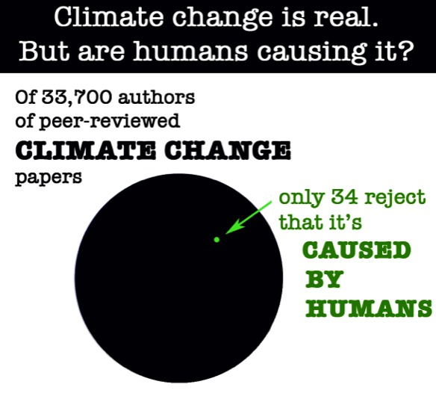
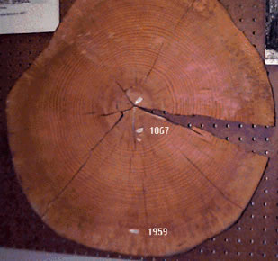
IB BIO – 4.4
31
Various Types of Evidence of Global Warming
Scientists measure: global temperatures, sea levels, ocean pH, ocean temperatures, the size of glaciers and polar ice caps, frequency and extent of extreme weather events, occurences of desertification,
- CO2 concentrations (H isotypes in bubbles) in ice cores (up to 650,000 years ago info on precipitation rate, melt layers, past temperatures and ghgs), radio-carbon dating (C-14 vs. C-12), tree growth rings (moisture levels, temperature, cloud cover) and pollen grains
Key Terms
ice cores
Climate modeling
Spatial distribution and abundance maps
Tree growth rings
http://www.priweb.org/globalchange/climatechange/studyingcc/scc_01.html
http://www.climate-change-guide.com/evidence-of-climate-change.html

Slide 32
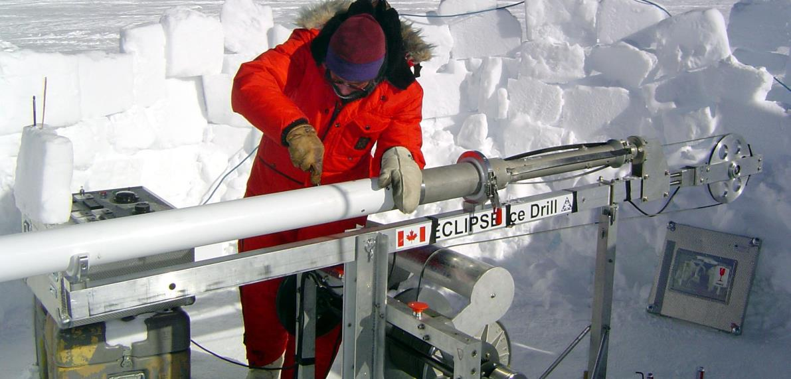
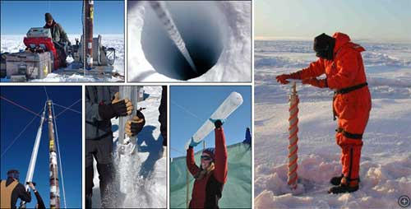
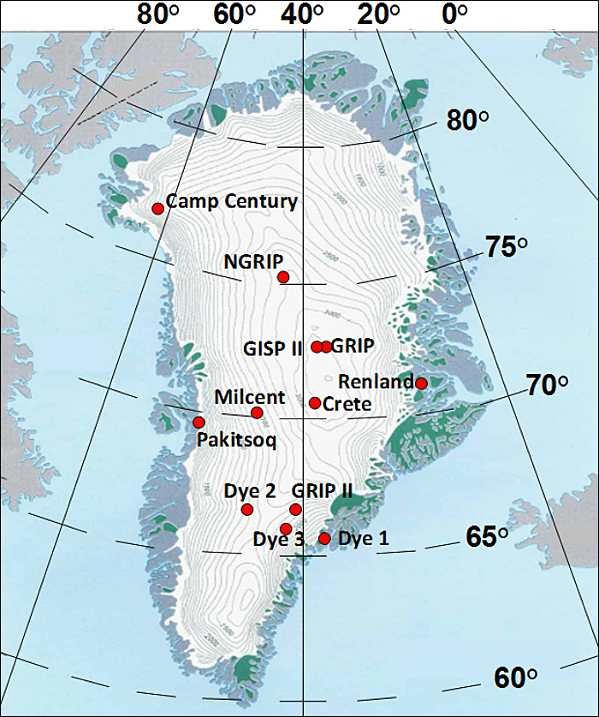
IB BIO – 4.4
32
Applications
A2: Correlations between global temperatures and carbon dioxide concentrations on Earth
CO₂ concentrations from the past can be determined by drilling ice cores. Scientists extract air bubbles from different depths and are able to determine CO₂ levels from that point in Earth’s history.
Checkout this link:
http://icecores.org/icecores/drilling.shtml
Past temperatures can also be determined by measuring the ratio of hydrogen isotopes in the water molecules.
Key Terms
ice cores
https://tallbloke.files.wordpress.com/2016/02/ice-sci1.jpeg

Slide 33
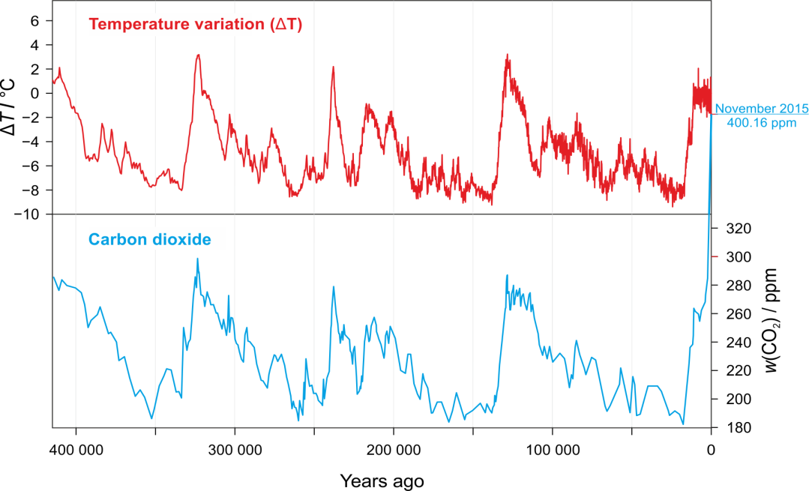
IB BIO – 4.4
CO₂ vs. Temperature
33
Applications
A2: Correlations between global temperatures and carbon dioxide concentrations on Earth
The graph here shows the correlation between CO₂ and temperature for the past ~400,000 years.
Key Terms
correlation
http://www.periodni.com/gallery/vostok_ice_core_data.png

Slide 34
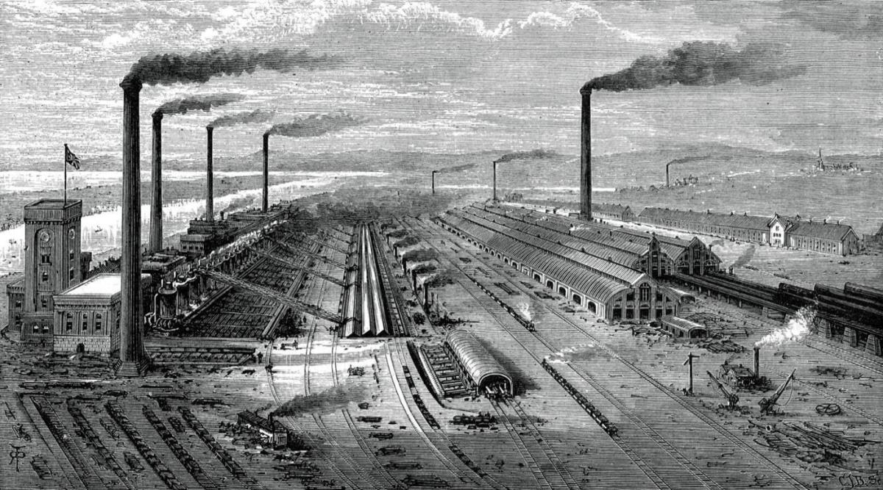
IB BIO – 4.4
The start of the Industrial Revolution (~200 ya) initiated a rapid increase in the combustion of fossil fuels. Since then, CO₂ levels in the atmosphere have continued to rise at an increasing rate
34
Understandings
U7: There is a correlation between rising atmospheric concentrations of carbon dioxide since the start of the industrial revolution 200 years ago and average global temperatures.
Key Terms
Industrial Revolution
http://globalwarming-facts.info/wp-content/uploads/ghg-trends.jpg

Slide 35
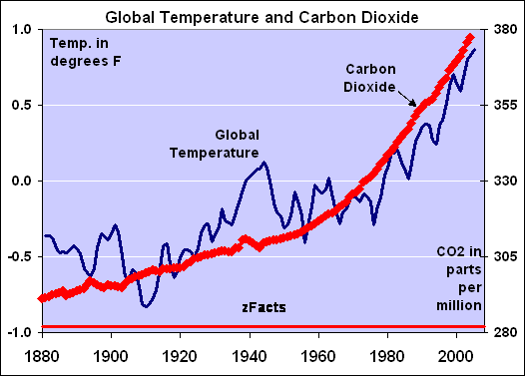
IB BIO – 4.4
Since the 1800’s, there has also been a strong correlation between CO₂ levels and global temperatures.
However, other events (like glaciation) can result in changes in temperature changes. Nevertheless, the CO₂-temperature relationship observed is strong.
35
Understandings
U7: There is a correlation between rising atmospheric concentrations of carbon dioxide since the start of the industrial revolution 200 years ago and average global temperatures.
Key Terms
Industrial Revolution
https://i0.wp.com/zfacts.com/metaPage/lib/zFacts-CO2-Temp.gif

Slide 36
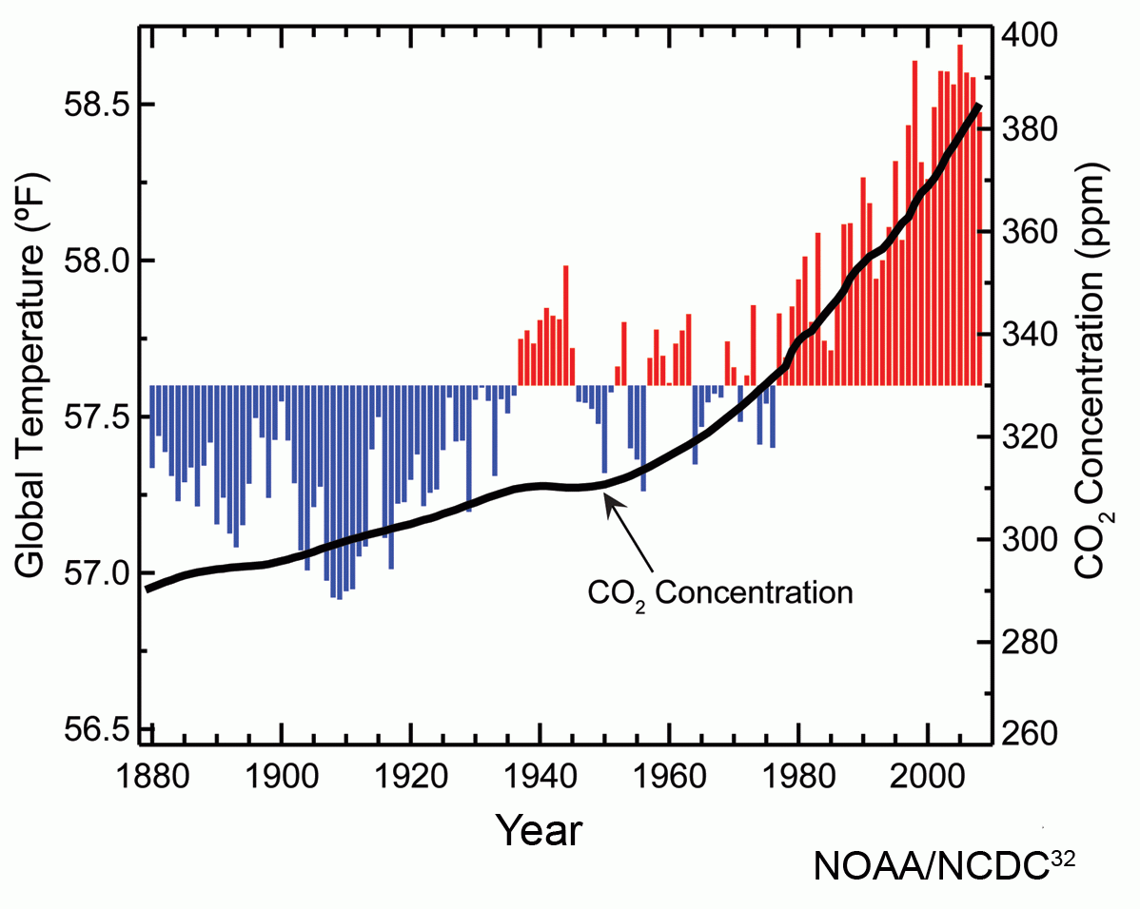
IB BIO – 4.4
During the 19th century, the combustion of oil, natural gas and coal become more widespread. Increases in fossil fuel combustion were most rapid from the 1950’s onwards, resulting in a steep rise in CO₂.
36
Understandings
U8: Recent increases in atmospheric carbon dioxide are largely due to increases in the combustion of fossilized organic matter.
Key Terms
http://globalwarming-facts.info/wp-content/uploads/ghg-trends.jpg
https://upload.wikimedia.org/wikipedia/commons/9/9e/Atmospheric_carbon_dioxide_concentrations.png

Slide 37
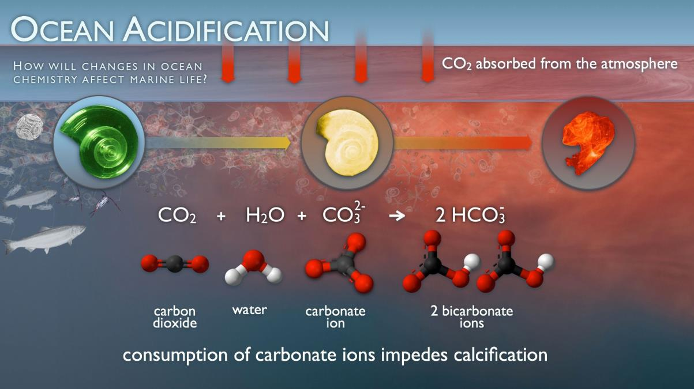
IB BIO – 4.4
In addition to increasing temperature, CO₂ levels are also having an effect on aquatic habitats. As CO₂ diffuses into oceans, it forms HCO₃⁻, which is lowers the overall pH and makes it acidic.
37
Applications
A1: Threats to coral reefs from increasing concentrations of dissolved carbon dioxide
Key Terms
http://pmel.noaa.gov/co2/files/pmel-oa-imageee.jpg

Slide 38
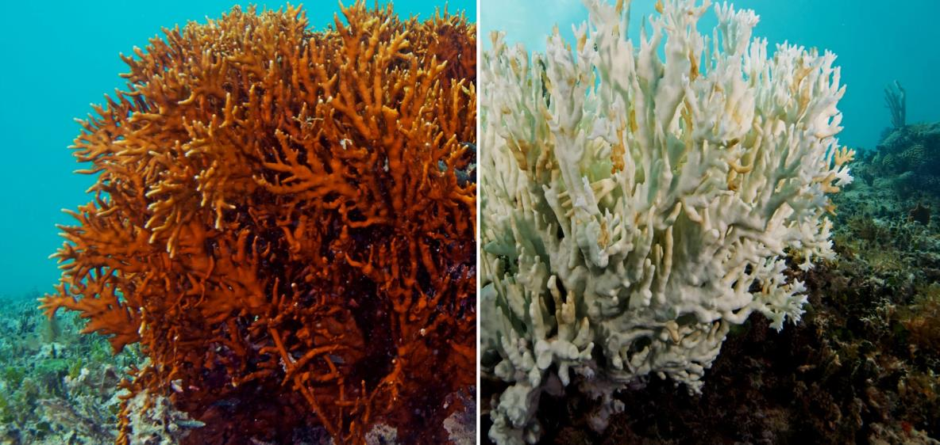
IB BIO – 4.4
The formation of carbonate ions reduces the overall availability of carbonate. However, corals use these ions to form exoskeletons.
As a result, increases in dissolved CO₂ prevent coral reefs from thriving. Large portions of the Great Barrier Reef have already begun to show signs of dying.
38
Applications
A1: Threats to coral reefs from increasing concentrations of dissolved carbon dioxide
Key Terms
http://www.popsci.com/sites/popsci.com/files/images/2015/10/coral-bleaching-7.jpg

Slide 39
http://oceanservice.noaa.gov/facts/coralbleaching-large.jpg

Slide 40
Marine Biodiversity Hotspots!

Slide 42
https://c2.staticflickr.com/4/3893/15218830466_0f672c98f3_b.jpg
http://www.bestamazingplacesonearth.com/wp-content/uploads/2014/10/Saudi-Arabia.jpg
https://s-media-cache-ak0.pinimg.com/736x/8c/2f/0a/8c2f0afdaf36386d12771441599f883d.jpg
http://www.silvija.net/2002SaudiMay/ABilyab1.jpg
https://sd.keepcalm-o-matic.co.uk/i/keep-calm-and-love-ksa-4.png

Slide 43
Desert Ecosystems are at Great Risk!
- Deserts have limited natural resources such as vegetation,
water and soil
Combined effects of global warming, decreased precipitation levels are resulting in significant habitat destruction
ectothermic animals (such as reptiles) in desert areas could reach their thermal threshold in the very near future
Data shows: increased mortality rates for plants and animals, animal migration (north), temperature-dependent sex determination in some species of turtles and lizards leading to endangered species and extinctions
Checkout these websites on climate change and Saudi Arabia:
http://climateactiontracker.org/countries/saudiarabia.html
http://www.sciencedirect.com/science/article/pii/S1319562X11000933
http://www.scidev.net/global/desert-science/news/climate-change-to-hit-saudi-s-agriculture-water.html

Slide 44
Williams, Shobrak, Wilms, Arif, and Khan (2012) conducted a study:
the effects of rising temperatures on the body temperature, abundance and distribution of the Arabian spiny-tailed lizard in Saudi Arabia
even with behavioral thermoregulatory mechanisms, the lizard’s body temperature typically reached 46 °C at midday on an average summer day, close to their upper thermal threshold of approximately 47 °C (body temperature).
Williams et al. (2012) warn that left unabated, global warming will lead to local and global extinctions of spiny-tailed lizards and other diurnal species of reptile
Reference:
Williams, J.B., Shobrak, M., Wilms, T.M., Arif, I.A., & Khan, H.A. (2012). Climate change
and animals in Saudi Arabia. Saudi Journal of Biological Sciences, 19, 121–130.

Slide 45
https://www.cdc.gov/climateandhealth/images/climate_change_health_impacts600w.jpg

Slide 46
IB BIO – 4.4
Despite strong correlations being observed, many claim that human activities are not causing climate change. Many such arguments use outlying years as evidence and ignore natural fluctuations on temp.
46
Applications
A3: Evaluating claims that human activities are not causing climate change
Key Terms
https://claytoonz.files.wordpress.com/2015/02/cjones02172015.jpg

Slide 47
https://s-media-cache-ak0.pinimg.com/736x/3a/2f/c5/3a2fc5ffad33a7b6589776b5d55f6c55.jpg
http://jeffreyhill.typepad.com/.a/6a00d8341d417153ef01b7c7f9df40970b-800wi

Slide 48
IB BIO – 4.4
48
Research these topics and teach your group members:
What types of evidence do climatologists use to predict climate patterns?
What is coral bleaching? Describe the threats faced by our coral reefs.
How is Saudi Arabia responding to climate change? Examine recent changes in legislation within the region for mitigating global warming.
Research action taken across the globe to mitigate climate change! How are different countries responding to this threat?
You Teach!

Slide 49
IB BIO – 4.4
49
National Geography: Climate Change 101
Gizmodo: Anti-climate Change Arguments and Why They’re Wrong
EU Climate Change: Causes and Consequences of Climate Change
Earth Touch: Coral Reefs & Climate Change
Interactive Article - The Impact of Climate Change on the Great Barrier Reef
https://www.theguardian.com/environment/ng-interactive/2014/mar/great-barrier-reef-obituary
VIDEOS

Slide 50
IB BIO – 4.4
50
Describe the effects of increasing greenhouse gas concentrations in the atmosphere.
Outline correlations between atmospheric CO₂ levels and global temperatures.
Describe the effect of the Industrial Revolution on atmospheric CO₂ levels.
Research the effects of CO ₂ levels on coral reefs.
Describe the local patterns in KSA; how are living organisms affected by climate change?
Do the research!

Slide 51
IB BIO – 4.4
Take a Look at these Websites:
Global Warming in the Arctic
http://www.npr.org/sections/thetwo-way/2016/12/13/505434080/scientists-report-the-arctic-is-melting-even-more-rapidly
2. Understanding the Skeptics
http://www.pbs.org/wgbh/nova/next/earth/climate-change-acceptance/
TED Talks – Climate Change (10)
https://www.ted.com/playlists/78/climate_change_oh_it_s_real
4. Saudi Arabia – legislation and indicators
http://www.lse.ac.uk/GranthamInstitute/legislation/countries/saudi-arabia/
51
Useful Links

Slide 52
A big thank you to Dr. Holt and to all of you wonderful Grade 11 girls!
https://s-media-cache-ak0.pinimg.com/736x/b1/70/4b/b1704b2576cf2b4a4117bae654d854be.jpg

