Slide 1
Genetics
Sections 3.2-3.4

Slide 2
3.2: Chromosomes
For prokaryotes, DNA is located in the nucleoid region in a long, continuous thread.
Plasmids are small loops of DNA that are not attached to the main strand. They replicate independently.
Plasmids help the cell adapt to unusual circumstances.
See the example on page 135 in your text.

Slide 3
Eukaryotes
DNA is coiled into chromosomes, which enables traits to be passed on.
Eukaryotes have more than one chromosome and each carries a different set of instructions for the cell.
Look at Table 3.5 in your text for a comparison of prokaryotes and eukaryotes.

Slide 4
Homologous Chromosomes
These are chromosomes that are similar in shape or size. They have the same genes, but may have different alleles. Therefore they are not identical.
The reason why there are two chromosomes is because one comes from the mother and one comes from the father.
**Recall the “Create A Baby” activity.

Slide 6
Diploid vs Haploid
Diploid (two) means chromosomes are organized into pairs of homologous chromosomes (HCs). Most cells are diploid (23 from mom and 23 from dad).
Gametes (sex cells) contain 23 total chromosomes. They do not pair up, which makes them haploid (half).

Slide 7
“n” represents the haploid number and refers to the number of sets of chromosomes a nucleus can have. For humans, n = 23.
When fertilization occurs, a zygote is formed and the haploid cells fuse, forming pairs.
As a result, humans have 2n. 2n = 46 chromosomes.
Diploid cells have 23 PAIRS of chromosomes.

Slide 8
Karyotypes
Karyotypes shows specific numbers of chromosomes and their appearance.
Chromosomes are ordered by decreasing length with the exception of the 23rd pair.
The 23rd pair are gametes and will be either XX or XY. The X chromosome is significantly larger than the Y.
The other 22 pairs are called autosomes.

Slide 9
Sex Determination
Women produce X gametes.
Males produce either X or Y gametes.
Sex of the offspring is always determined by the father.
Autosomal traits or genes are located on one of the 22 autosomes.
Sex-linked traits or genes are located on the 23rd pair of chromosomes.

Slide 10
Section Summary (p. 141)

Slide 11
3.3: Meiosis
Watch this video from the Amoeba Sisters. It is an overview of meiosis and compares it to mitosis. Be able to explain reduction division.
https://youtu.be/toWK0fIyFlY
Recall that mitosis produces diploid nuclei. Meiosis produces haploid nuclei.
Bear in mind that meiosis occurs in TWO stages: meiosis I and meiosis II. Be able to list the products of each stage.

Slide 12
Page 145-146 shows a detailed list of events during meiosis. It is a good idea to have an understanding of what’s happening during each substage.
Which stage of meiosis is similar to mitosis?

Slide 13
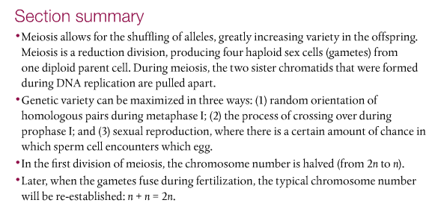
Section Summary (p. 145)

Slide 14
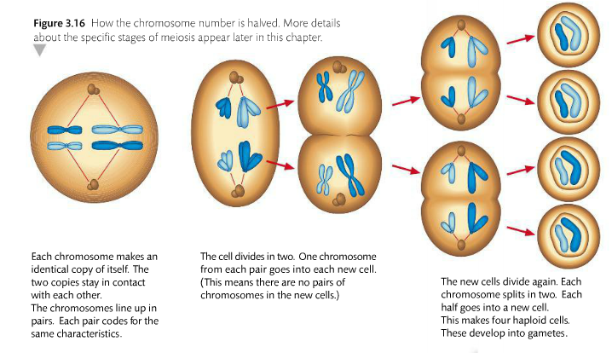
How haploid nuclei are formed

Slide 15
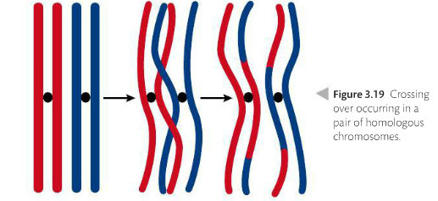
Crossing over yields genetic diversity

Slide 16
3.4: Inheritance
Inheritance refers to the characteristics offspring inherit from their parents.
You did this back in February when you got married and made babies. I will return your children to you so that you can examine them as you review this section in the text.
Page 151-2 provides a definitive list of the vocabulary you need to know for this section.

Slide 17
Gregor Mendel
Mendel was an Austrian monk who experimented with pea plants. He wanted to know how garden pea plants passed on their characteristics.
Page 150 provides a short NOS reading about Mendel’s work. It’s worth it to take a look at what it says.

Slide 18
Punnett Squares
Punnett Squares are a mathematical way to determine how alleles from both parents split and recombine in offspring.
The model is based on probability; it does not mean that is what is going to happen when parents produce offspring.

Slide 19
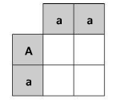
Can you complete this cross?

Slide 20
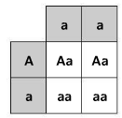

Slide 21
According to the results of the cross (which is the F1 (first filial) generation), each offspring has a 50% chance to obtain the Aa genotype and a 50% chance to obtain the aa genotype.
We will practice working with Punnett squares in class.

Slide 22
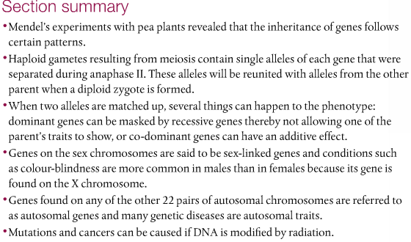
Section Summary (p. 165)

Slide 23
Notes
Review pages 158-161 on genetic diseases.
We will work on pedigree charts in class.
Be sure to go back and review the sections to answer the questions I’m going to give you.
Your exam over this chapter will be during the 3rd week of April.

