Slide 1
C8: Photovoltaic Cells & Dye-sensitized Solar Cells (AHL)
By Clara Sastra
Notes:
Due 1st of February 2019
Your lesson should be no more than 35 minutes long. All lessons must include: 1. Some sort of introduction and/or warmup 2. Section Objectives 3. Notes for students to take (make use of the YouTube videos on Option C) 4. Short lecture and explanation of the concepts (minimum 8 minutes, maximum 12 minutes) 5. Images, diagrams, concept maps, handouts etc. 6. Review of the lesson objectives and a Q/A session 7. Lesson Summary 8. Practice problems*

Slide 2
Objectives
Understanding:
Molecules with longer conjugated systems absorb light of longer wavelength.
The electrical conductivity of a semiconductor increases with an increase in temperature whereas the conductivity of metals decreases.
The conductivity of silicon can be increased by doping to produce n-type and p-type semiconductors.
Solar energy can be converted to electricity in a photovoltaic cell.
DSSCs imitate the way in which plants harness solar energy. Electrons are “injected” from an excited molecule directly into the TiO2 semiconductor.
The use of nanoparticles coated with light absorbing dye increases the effective surface area and allows more light over a wider range of the visible spectrum to be absorbed.

Slide 3
Silicon-Based Photoelectric Cells
Silicon is a semiconductor > Conductivity of semiconductors increases with increased temperature.
Note: Conductivity of metal decreases with increased temperature
Silicon crystal contains a lattice of silicon atoms with covalent bonds.
Electrons are in fixed positions > Poor conductor under normal conditions.
Basis of photoelectric effect and theory behind solar powered batteries.
Energy is required to excite and free an electron from its bonding position.
Energy required is equivalent to energy of light ($1.1×{10}^{−6}m$).
Energy of light has a longer wavelength and a higher energy than visible light ($4−7×10^{−7}m$). > Sunlight photons can excite a valence electron in silicon.
Electrons which are free to move through the crystal lattice in the conduction band becomes an electrical conductor.
Solar cells, in practice, is not very efficient and it is costly to purify silicon, but they are non-polluting and does not utilize fossil fuel reserves.

Slide 4
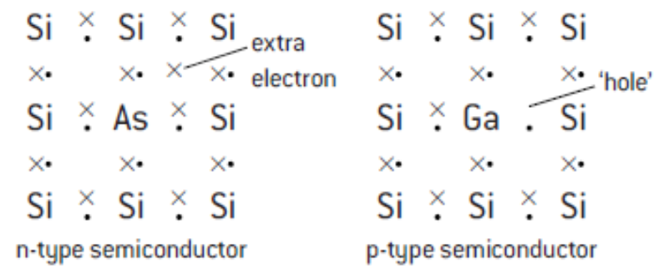
Silicon-Based Photoelectric Cells
Doping: A method of improving the photoelectric effect efficiency.
Involves adding small amounts of atoms of other elements:
From group 13 (Al, Ga, In)
Added extra electron can move easily through the crystal lattice > Makes it a better conductor compared to pure silicon.
its conductivity stems from negative electrons. > Produce an n-type semiconductor
From group 15 (P or As)
The element will have one less electron than silicon. > Creates a ‘hole’ in the lattice.
When free electrons move into the hole, it produces a new hole where the electron was formerly located.
Produces p-type semiconductor > the hole can be regarded as a positive carrier.

Slide 5
Dye-Sensitized Solar Cells (DSSCs)
In the DSSC, the photoelectrons originate from the dye when it absorbs light and then transported through a semi conductor.
Normal C=C double bond from an organic compound absorbs.
Electron is excited to higher energy level during the process.
Compound containing many alternate double and single carbon to carbon bonds are said to be conjugated
Energy required to excite an electron is lower.
More conjugated molecules = lower energy of light required.
E.g. Chlorophyll and α-carotene → highly conjugated = absorb in the visible region.
Notes:
While within silicon-based cell, silicon provides both the source and means of electron conductivity; the photoelectrons, in the DSSC, originate from the dye when it absorbs light and are then transported through a semi conductor.

Slide 6
Dye-Sensitized Solar Cells (DSSCs)
Dyes absorbs in the visible region and sunlight interacts with dyes which are used in Grätzel DDSCs to produce photoelectrons.
The Grätzel DDSC consists of three parts
Cathode and anode sealed together
Anode made of tin(IV) oxide ($SnO_{2}$) which is doped with fluoride ions on a transparent plate and covered by a thin layer of titanium (IV) oxide $(TiO_{2}$) nanoparticles.
Provides large surface area where the photosensitivity dye covalently bonds and allows a wider range of the visible spectrum to be absorbed.
Cathode consisting of an iodide electrolyte on a thin sheet of conducting metal (e.g. platinum).

Slide 7
Dye-Sensitized Solar Cells (DSSCs)
7 Steps: They imitate the method plants harvest solar energy.
Photon is released from the sun.
Different wavelengths of photon can be used in the solar cell – by product of nanoparticles.
Photon hits dye and ejects electron from conjugated bond.
Conjugated bond = Sequential single and double bonds in an organic molecule.
Electrons gets “injected” into the $TiO_{2}$semiconductor.
Electron moves through $TiO_{2}$ nanoparticles and exits anode.
Nanoparticles have a large surface area and are very small
Allows for lots of dye can be made available to work for the solar cell.
Allows for different wavelength of light to work for the solar cell.
Electron flows towards the transparent tin-based anode, through the circuit and does “work.”
Work = Electrical activity
Electron returns to platinum cathode and flow into iodide electrolyte.
Electrolyte transport electron back to dye.
$I_{3}^{−}+2e^{3}↔3I$
Repeat.

Slide 8
Review of the Lesson Objectives
Advantages of DSSCs over silicon-based photoelectric cells:
Simple to make
Semi-flexible
Semi-transparent
Cheaper
Absorbs a wider range of wavelength -> More efficient

Slide 9
Summary
The electrical conductivity of a semiconductor increases with increased whereas the conductivity of metals decreases.
Doping increases conductivity of silicon by producing n-type and p-type semiconductors.
Solar energy can be converted to electricity in a photovoltaic cell.
Molecules with longer conjugated systems absorb light of longer wavelength.
DSSCs imitate the way in which plants harness solar energy. Electrons are “injected” from an excited molecule directly into the TiO2 semiconductor.
The use of nanoparticles coated with light absorbing dye increases the effective surface area and allows more light over a wider range of the visible spectrum to be absorbed.

Slide 10
Practice Problems
Notes:
doping with/adding small quantities of a Group 3 element (B, Al etc.); atoms contain less electrons so give “positive holes”/“electron holes” (in the filled band); these “holes” are able to move and hence allow the silicon to conduct / OWTTE;

Slide 11
Practice Problems
Notes:
Any three of:
dye has conjugated system ✔
dye absorbs a photon «and injects an electron into TiO2»✔
electrons transferred to semiconductor «and dye ionized»✔
dye oxidizes/takes electron from electrolyte ✔
electron flows through external circuit «to reduce electrolyte»✔
Notes:
M4 may also be scored from more
detailed answers involving iodide
species (eg “iodide/$I^{−}$ oxidized to
$I_{3}^{−}$/triiodide” OR “$I^{−}$/iodide reduces dye”
OR “$I^{−}$/iodide releases electron to dye”
OR “$I_{3}^{−}$/triiodide reduced to $I^{−}$/iodide”).

Slide 12
Bibliography
Bylikin, Sergey, et al. Chemistry. Great Briain: Oxford University Press, 2014. Textbook.

